Slide 1
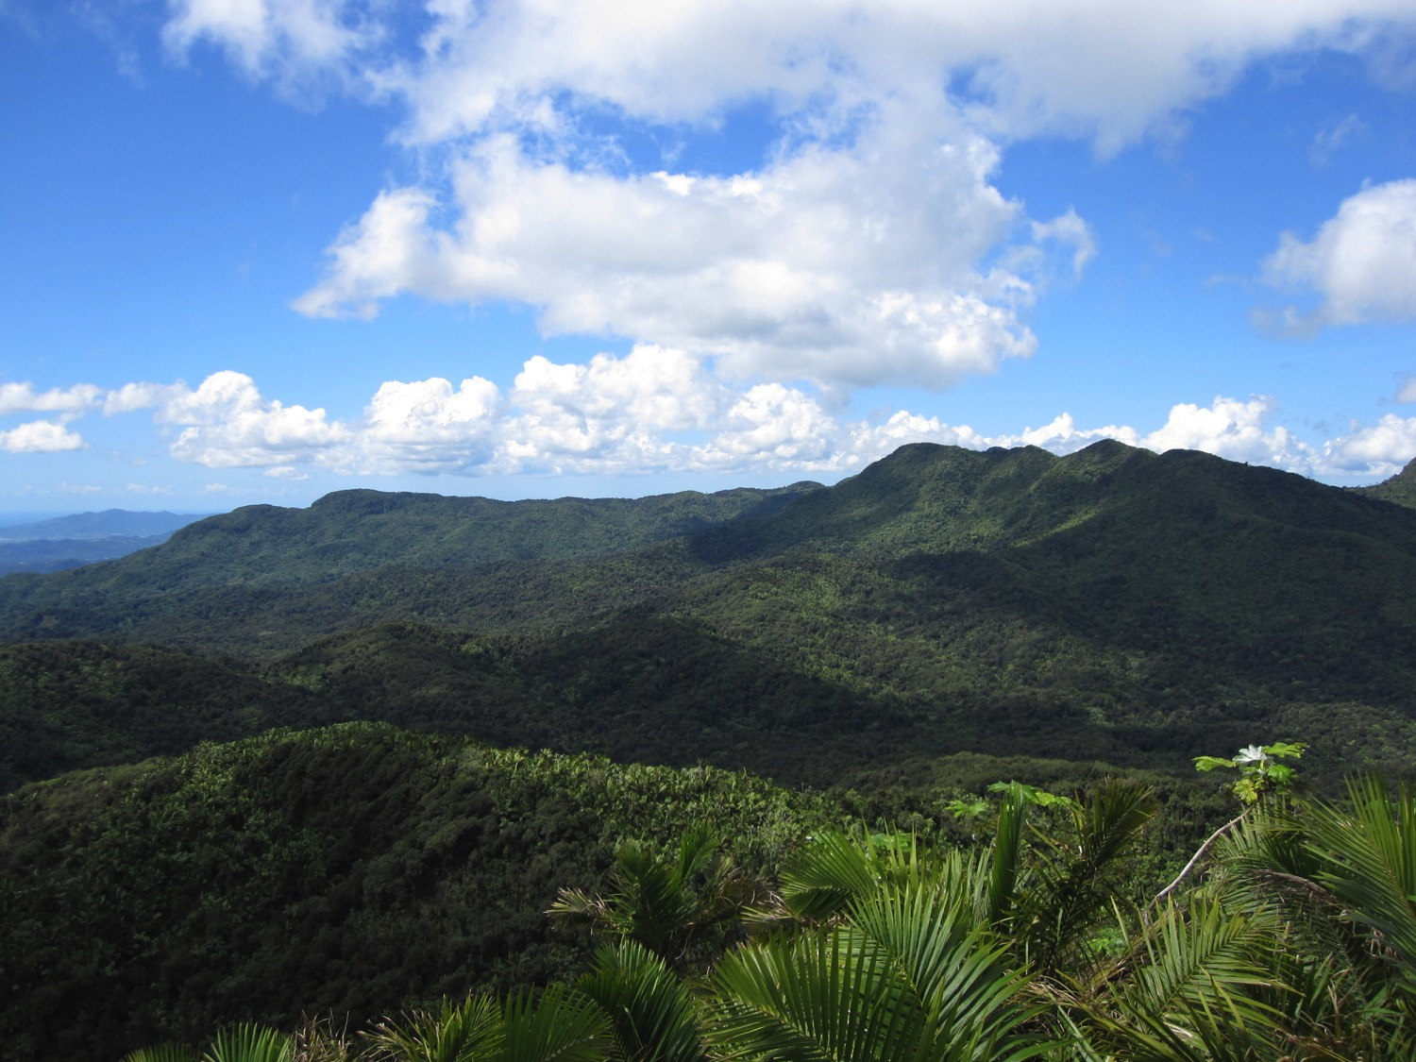
The Luquillo LTER A Tour in Pictures
Notes:
A view of the Luquillo Mountains prior to Hurricane Maria

Slide 2
Field Station Road
Notes:
A typical view along the road up to the field station, most of this foliage is bamboo

Slide 3
Field Station Road
Notes:
Bridge over a mountain stream near the field station

Slide 4
Field Station Road
Notes:
Rivers rise quickly for a short time after heavy rains.

Slide 5
Driveway to Field Station
Notes:
Entrance to the field station.

Slide 6
Driveway to Field Station

Slide 7
El Verde Field Station
Notes:
The field station is in an isolated area. Anywhere from 15-35 people will be living there during the summer with many others arriving each day to work that may live elsewhere. The field station does have wifi, power, running water, and usually good enough cell service to text or make phone calls. However, because of the remote location, it isn’t unusual for power or water to go out. There is a backup generator for emergencies. [Note: Since Hurricane Maria, the field station has not been reconnected to the power grid. It runs on a generator that supplies power, which is generally turned on from around 7 am to 2:30 pm and again from around 6 pm to 9 pm, depending on the day of the week and what is going on. This actually works pretty well, you just need to carry a light around at night.]
There will be people at the station from many different universities, providing the opportunity to meet people with different interests, expertise, and backgrounds.

Slide 8
El Verde Field Station
Notes:
There are multiple office and lab spaces, common areas, living areas, and two kitchens.
Because it is a communal living situation and you will be a representative of our research group and of UConn, it is important to behave appropriately. This doesn’t mean we don’t have a good time, just that you want to clean up any messes you make in the common areas and maintain a reasonable volume when people are sleeping as we work primarily at night.

Slide 9
El Verde Field Station
Notes:
Typical dorm room at the field station. Rooms typically accommodate between 6 and 14 people, depending on the room.
The forest can be quite loud at night with the frogs calling and if it is raining, so noise from the common areas is not usually a problem.

Slide 10
El Verde Field Station
Notes:
Conference room at the field station. This room is part of the field station that lost its roof. The roof has been replaced and this area may be available for use again in 2020.

Slide 11
Rain
Notes:
It rains sometimes. We’ll be there during the wet season, so it will probably be raining a lot of sometimes.

Slide 12
And rain…

Slide 13
More rain…

Slide 14
Lots and lots and lots of rain…

Slide 15
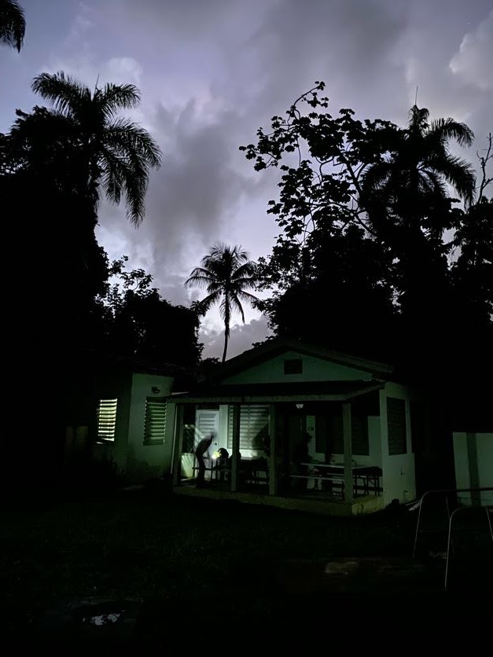
El Verde Field Station
Notes:
But it doesn’t rain all of the time.

Slide 16
Beginning of trail into the Forest

Slide 17
Trail to the Big Grid
Notes:
Suspension bridge over a stream on the way to the field sites. Again, we work at night so most of the time all you see is what is illuminated with your headlamp.

Slide 18
Trail to the Big Grid
Notes:
View of the Sonadora, looking uphill, from the suspension bridge.

Slide 19
Walking in the Forest
Notes:
You’ll get wet…and muddy. But under the forest canopy, it can rain quite a bit before you actually feel any of it making its way down to you. [Note: this is less true since Hurricane Maria as the canopy has not fully re-grown, yet.]

Slide 20
Walking in the Forest

Slide 21
Grid Points
Notes:
The forest is pretty safe. The most dangerous thing is falling or slipping on rocks. No big animals or poisonous beasts….except for chupa cabras.
Note: the forest understory is not this open now, but it is improving every year.

Slide 22
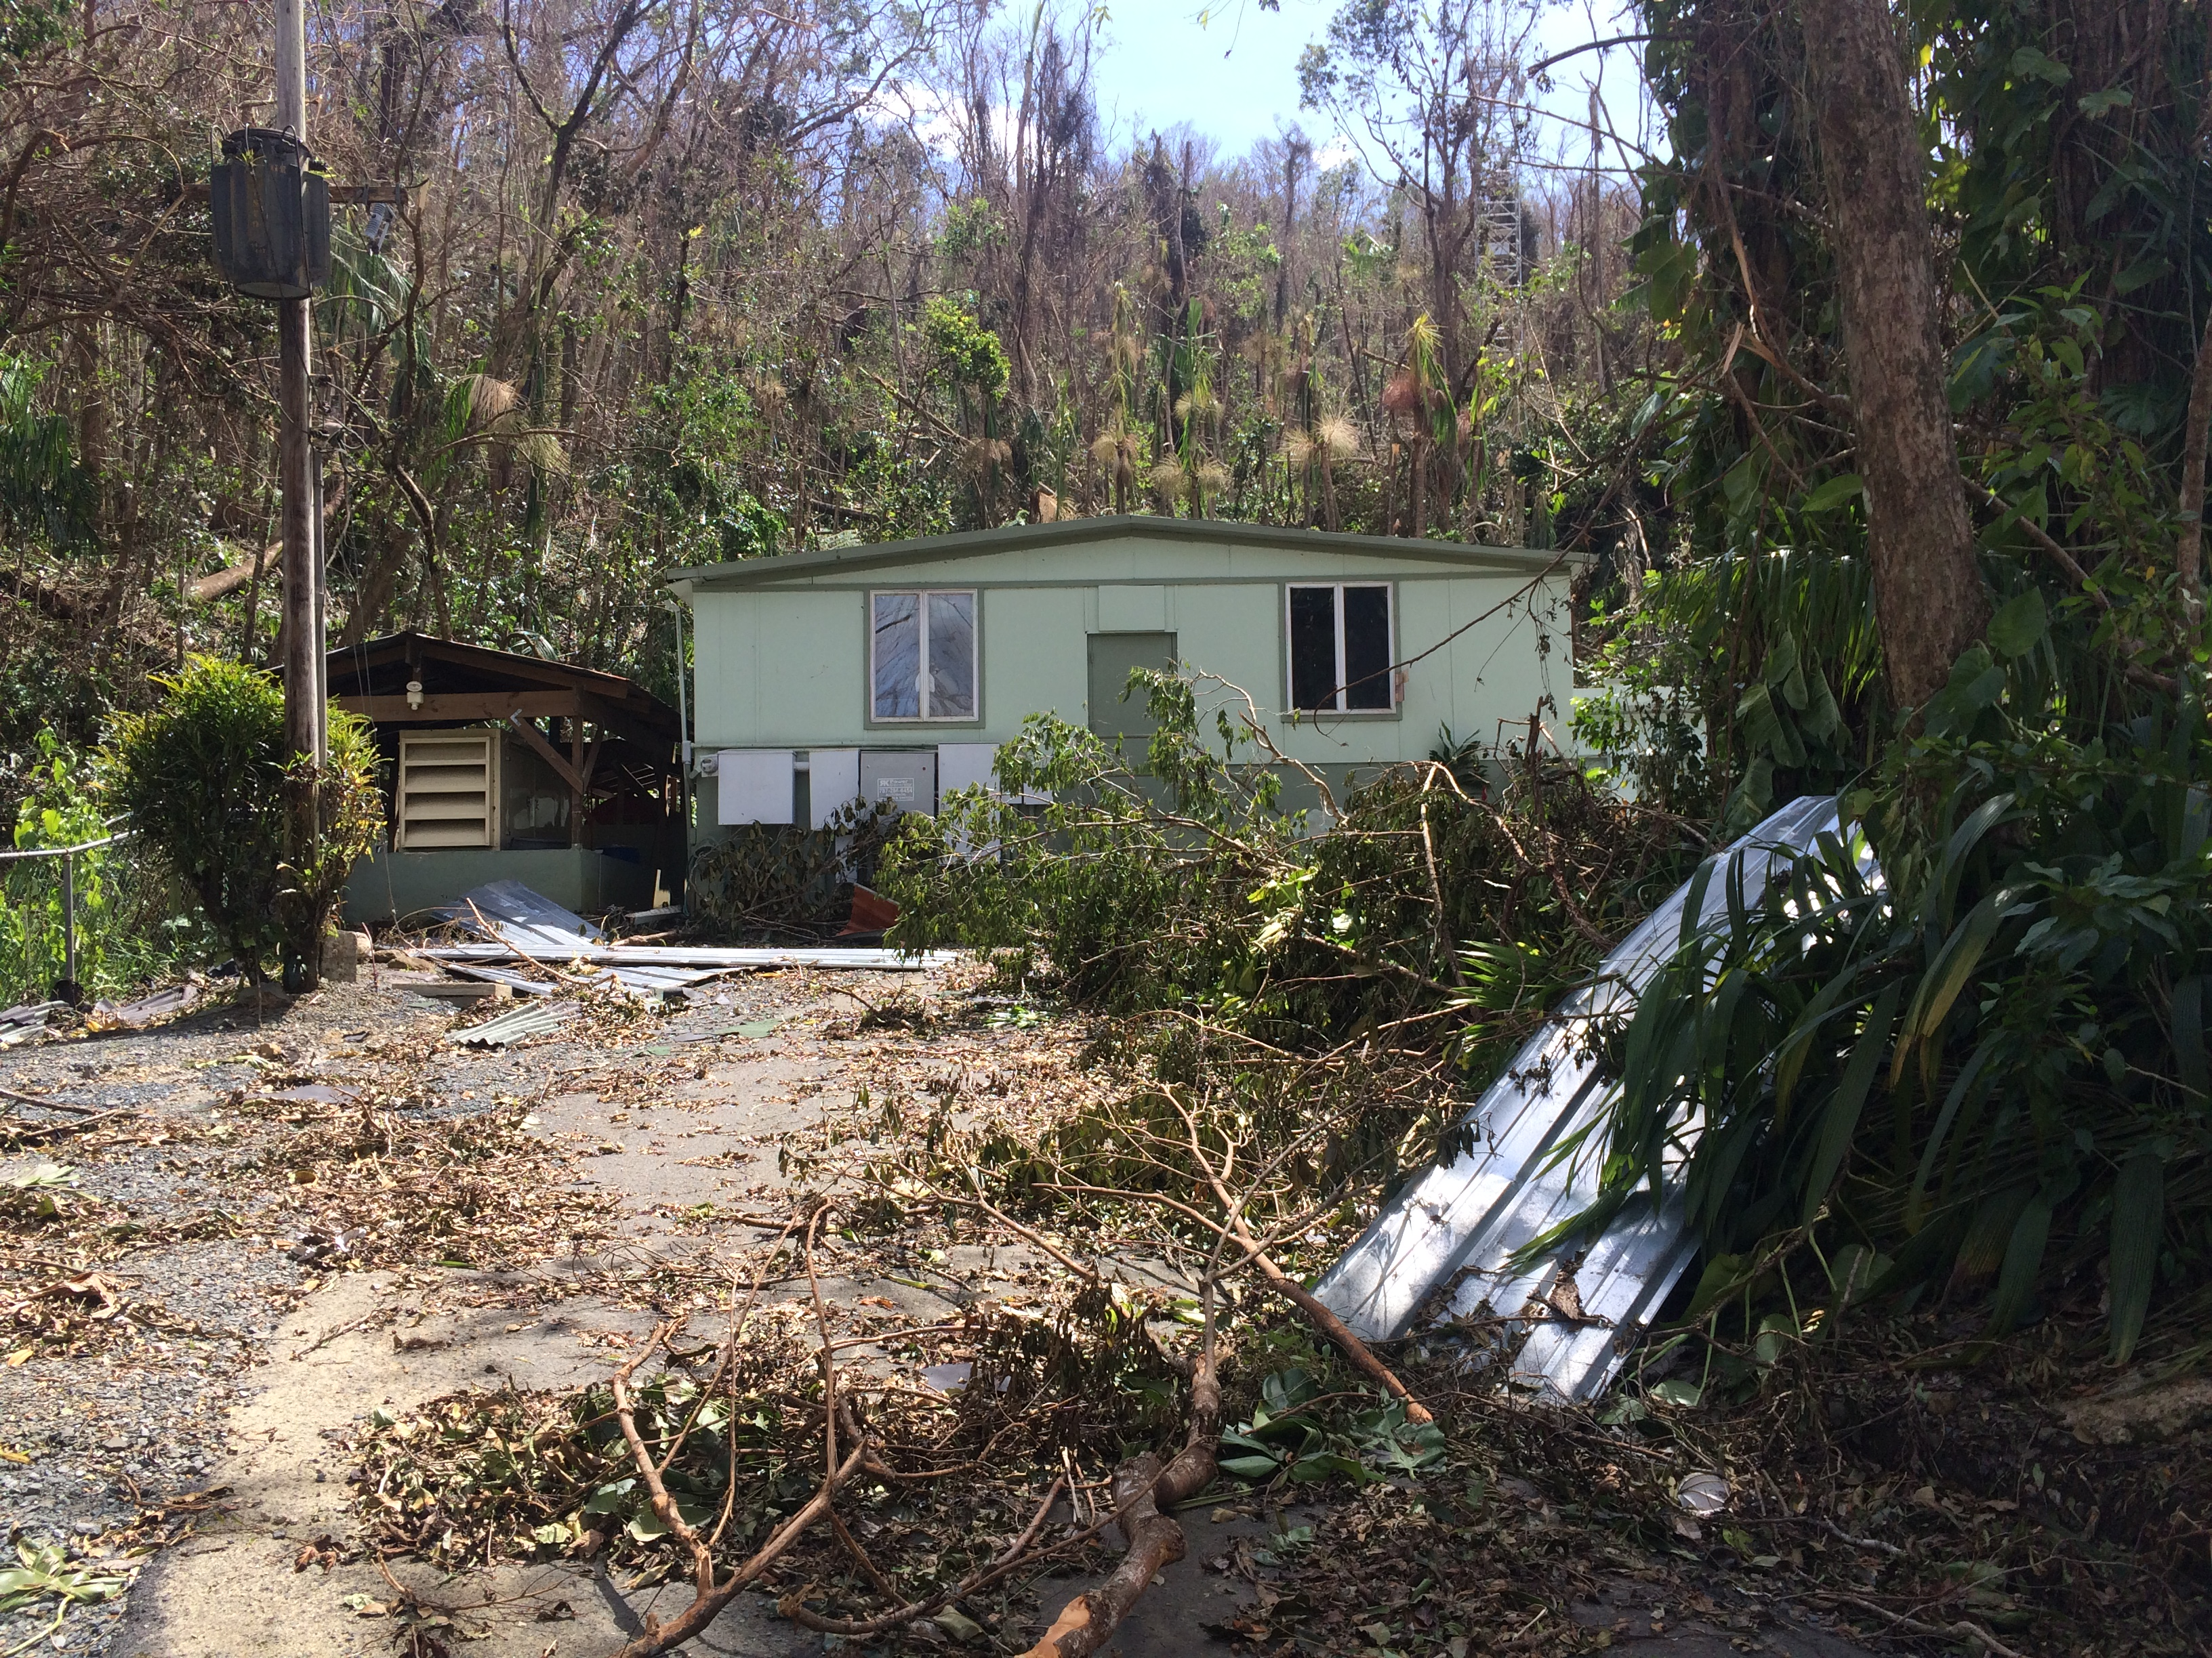
Hurricane Maria
Notes:
The field Hurricane Maria killed most mature trees in the forest.

Slide 23
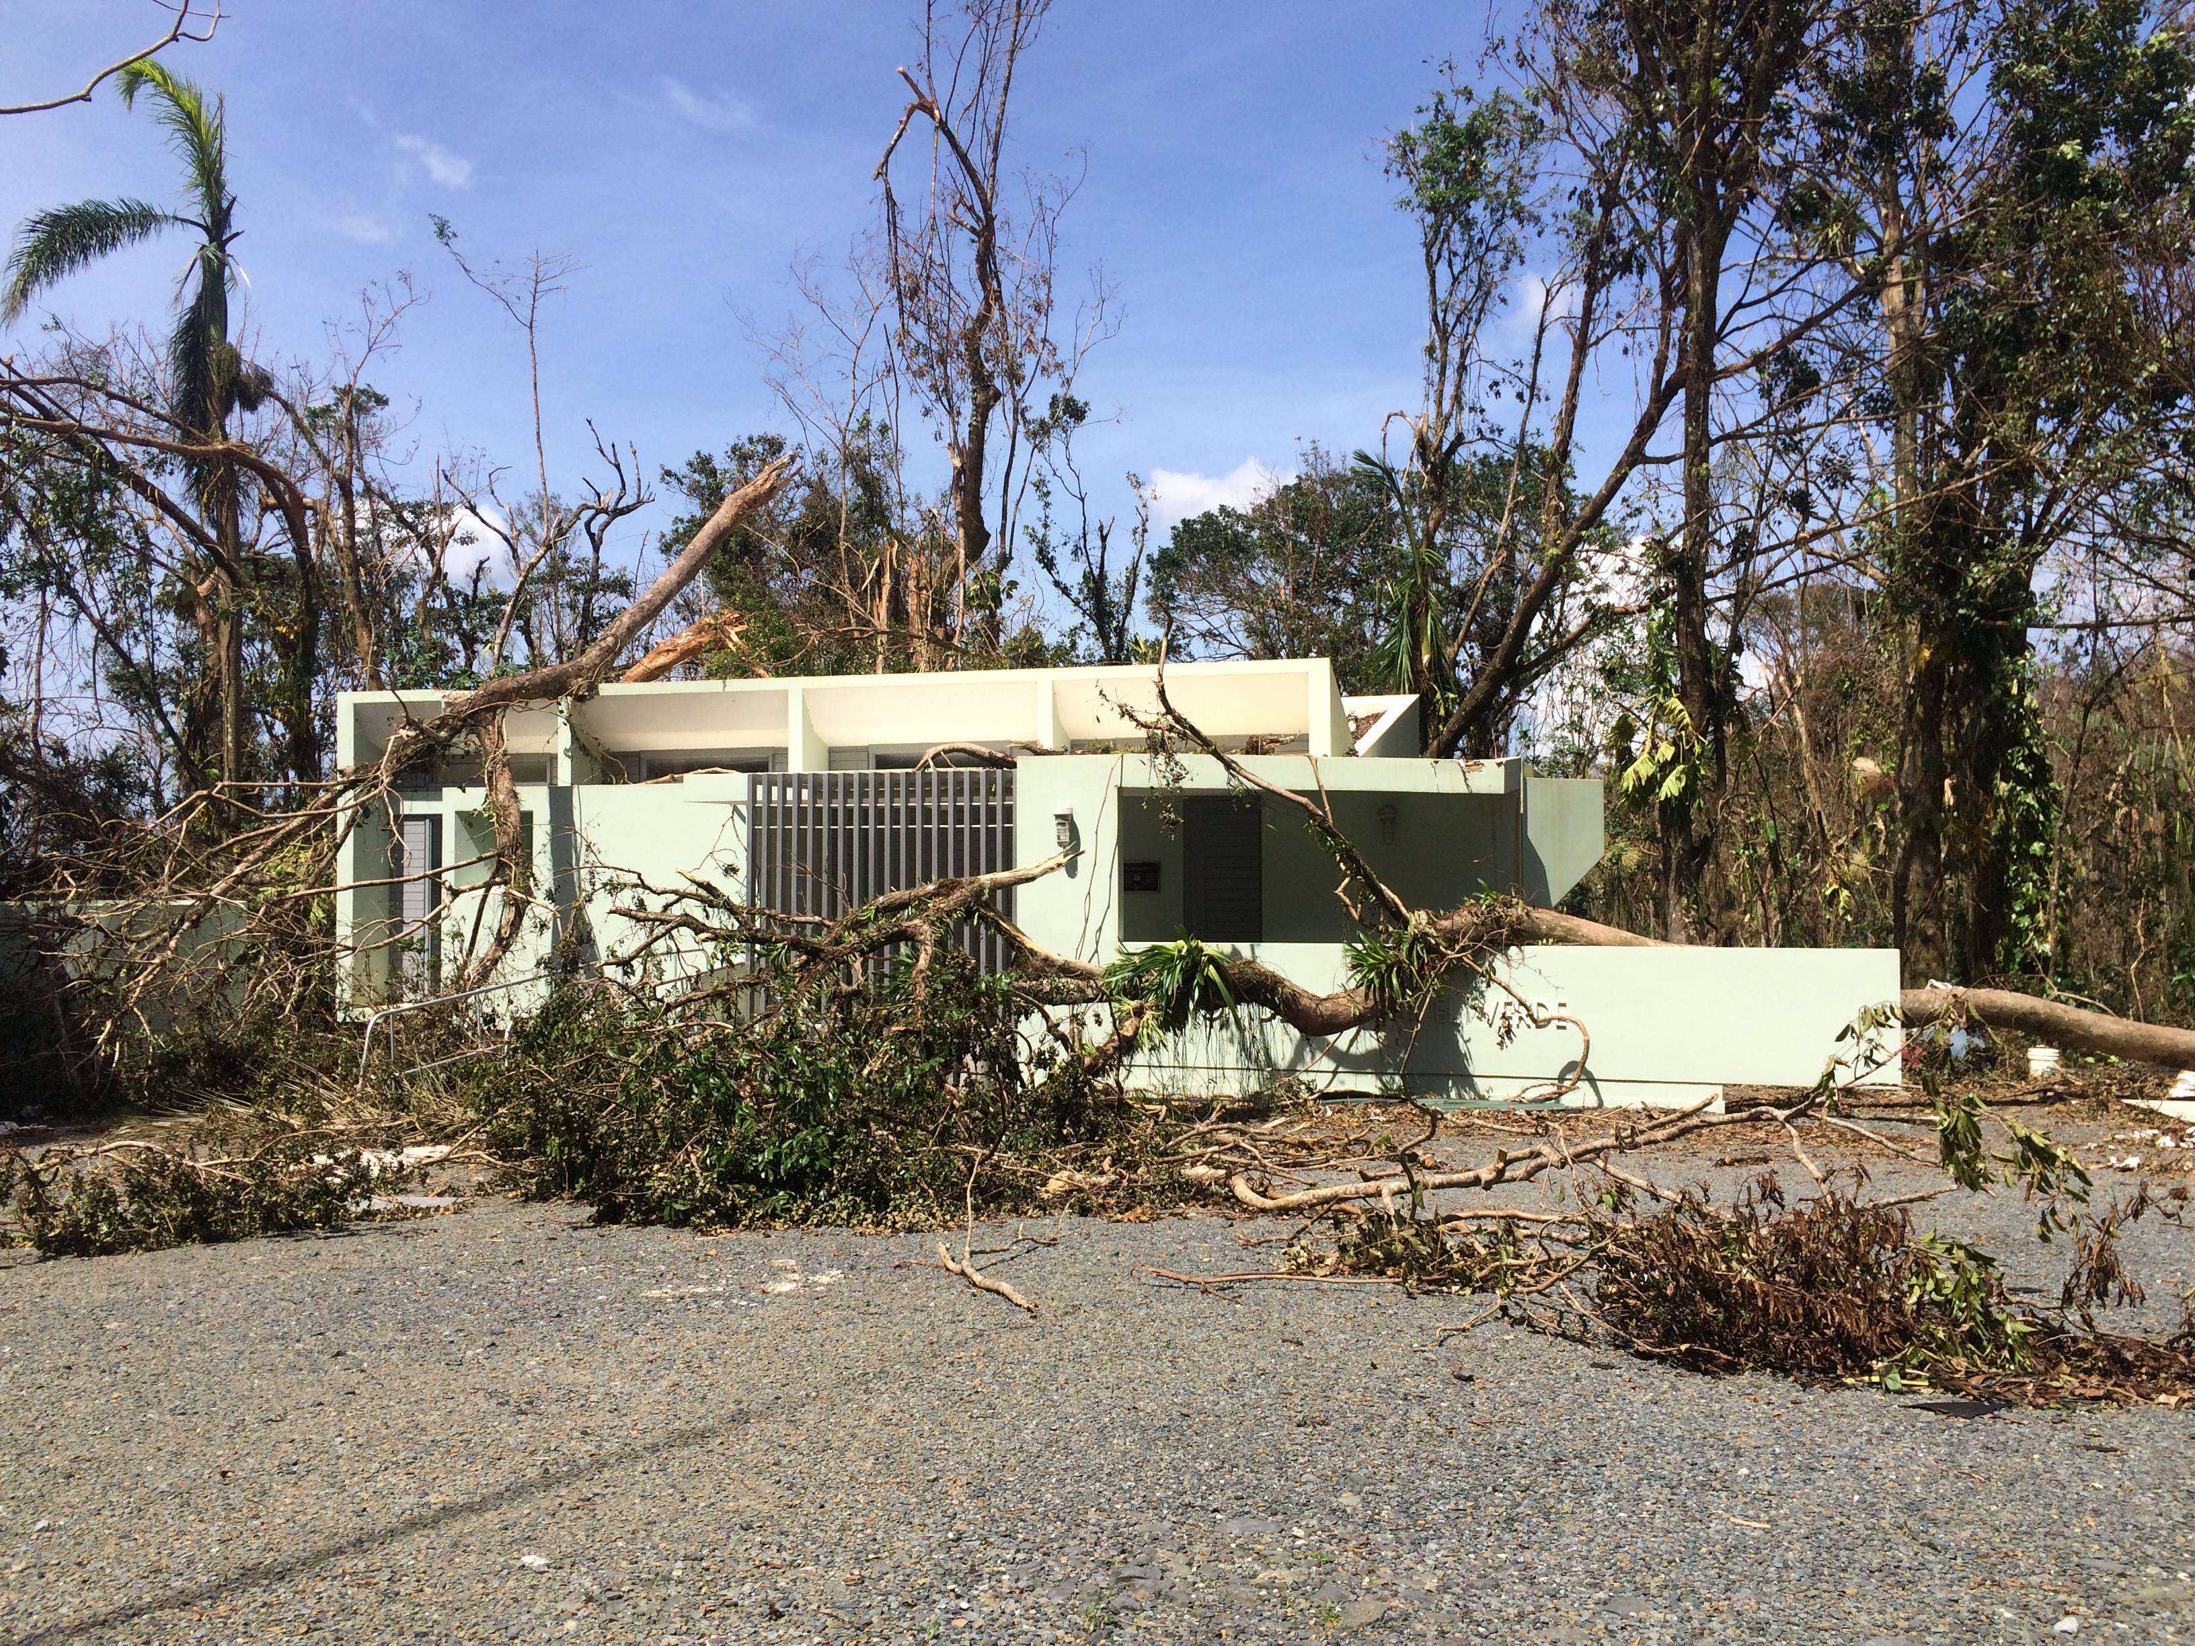
Hurricane Damage
Notes:
The field station did take some damage during Hurricane Maria.

Slide 24
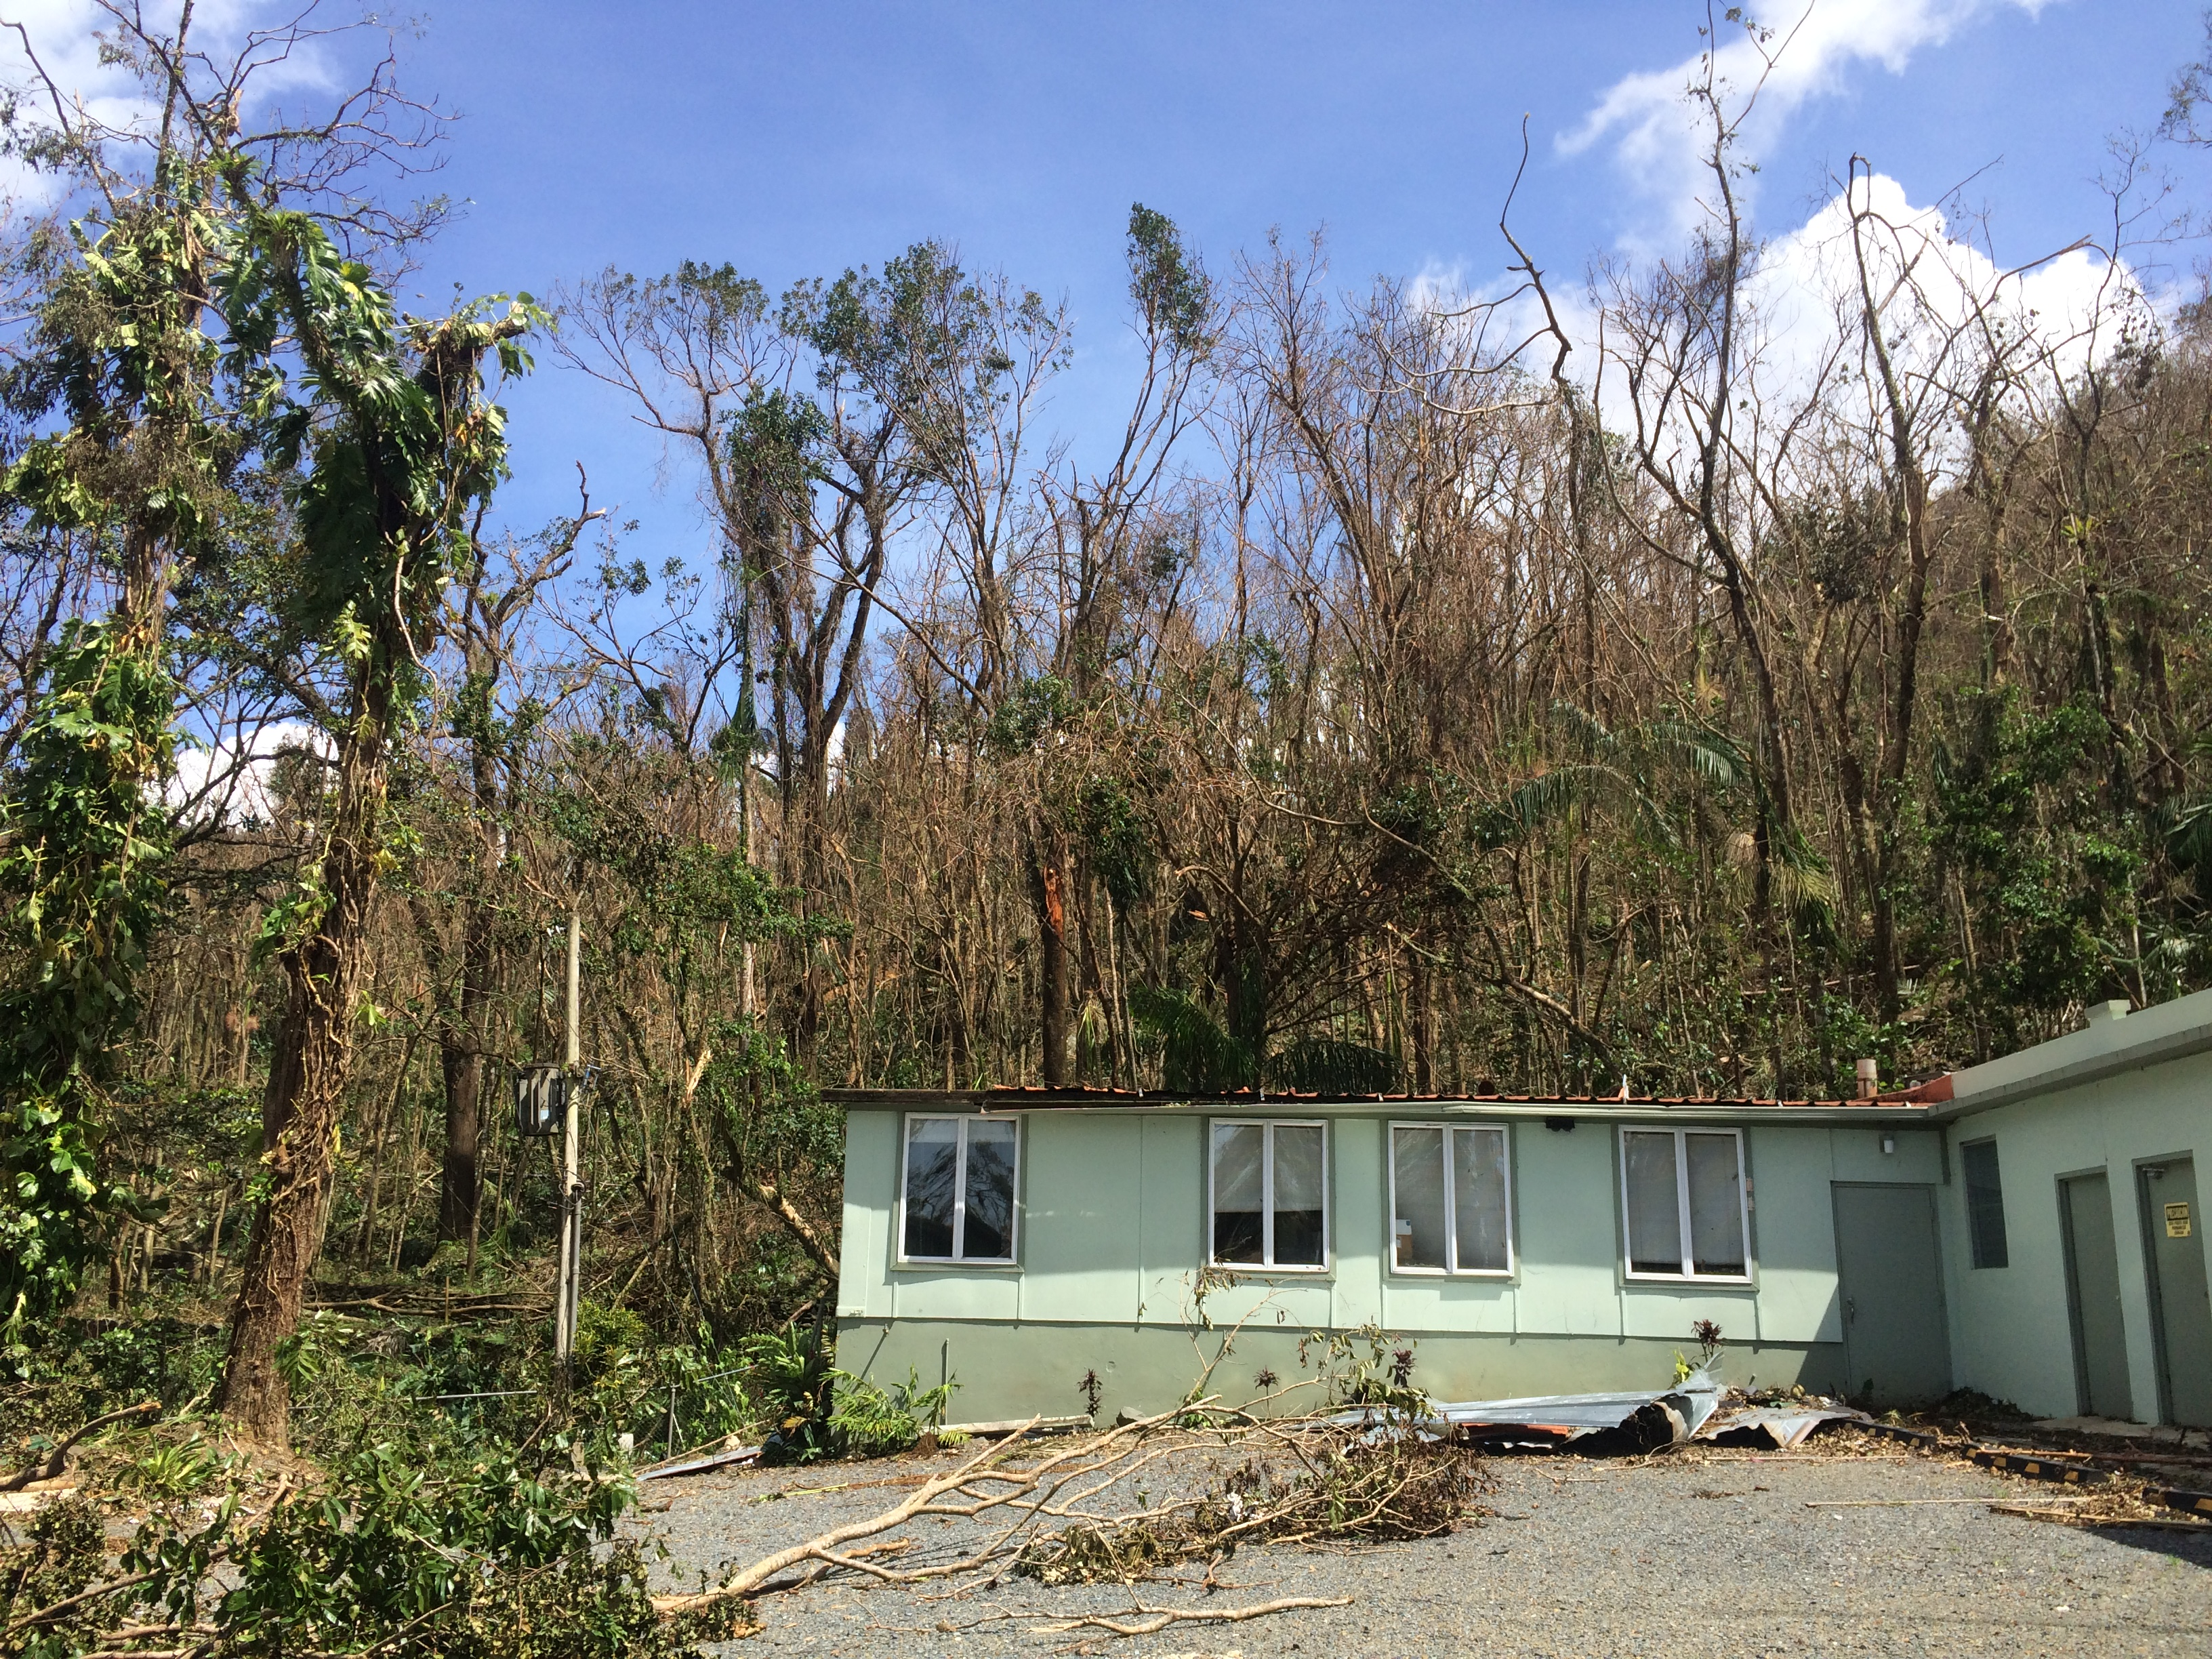
Hurricane Damage
Notes:
This building had its tin roof torn off, so it flooded. The roof has been replaced and it may be ready for use again this summer.

Slide 25
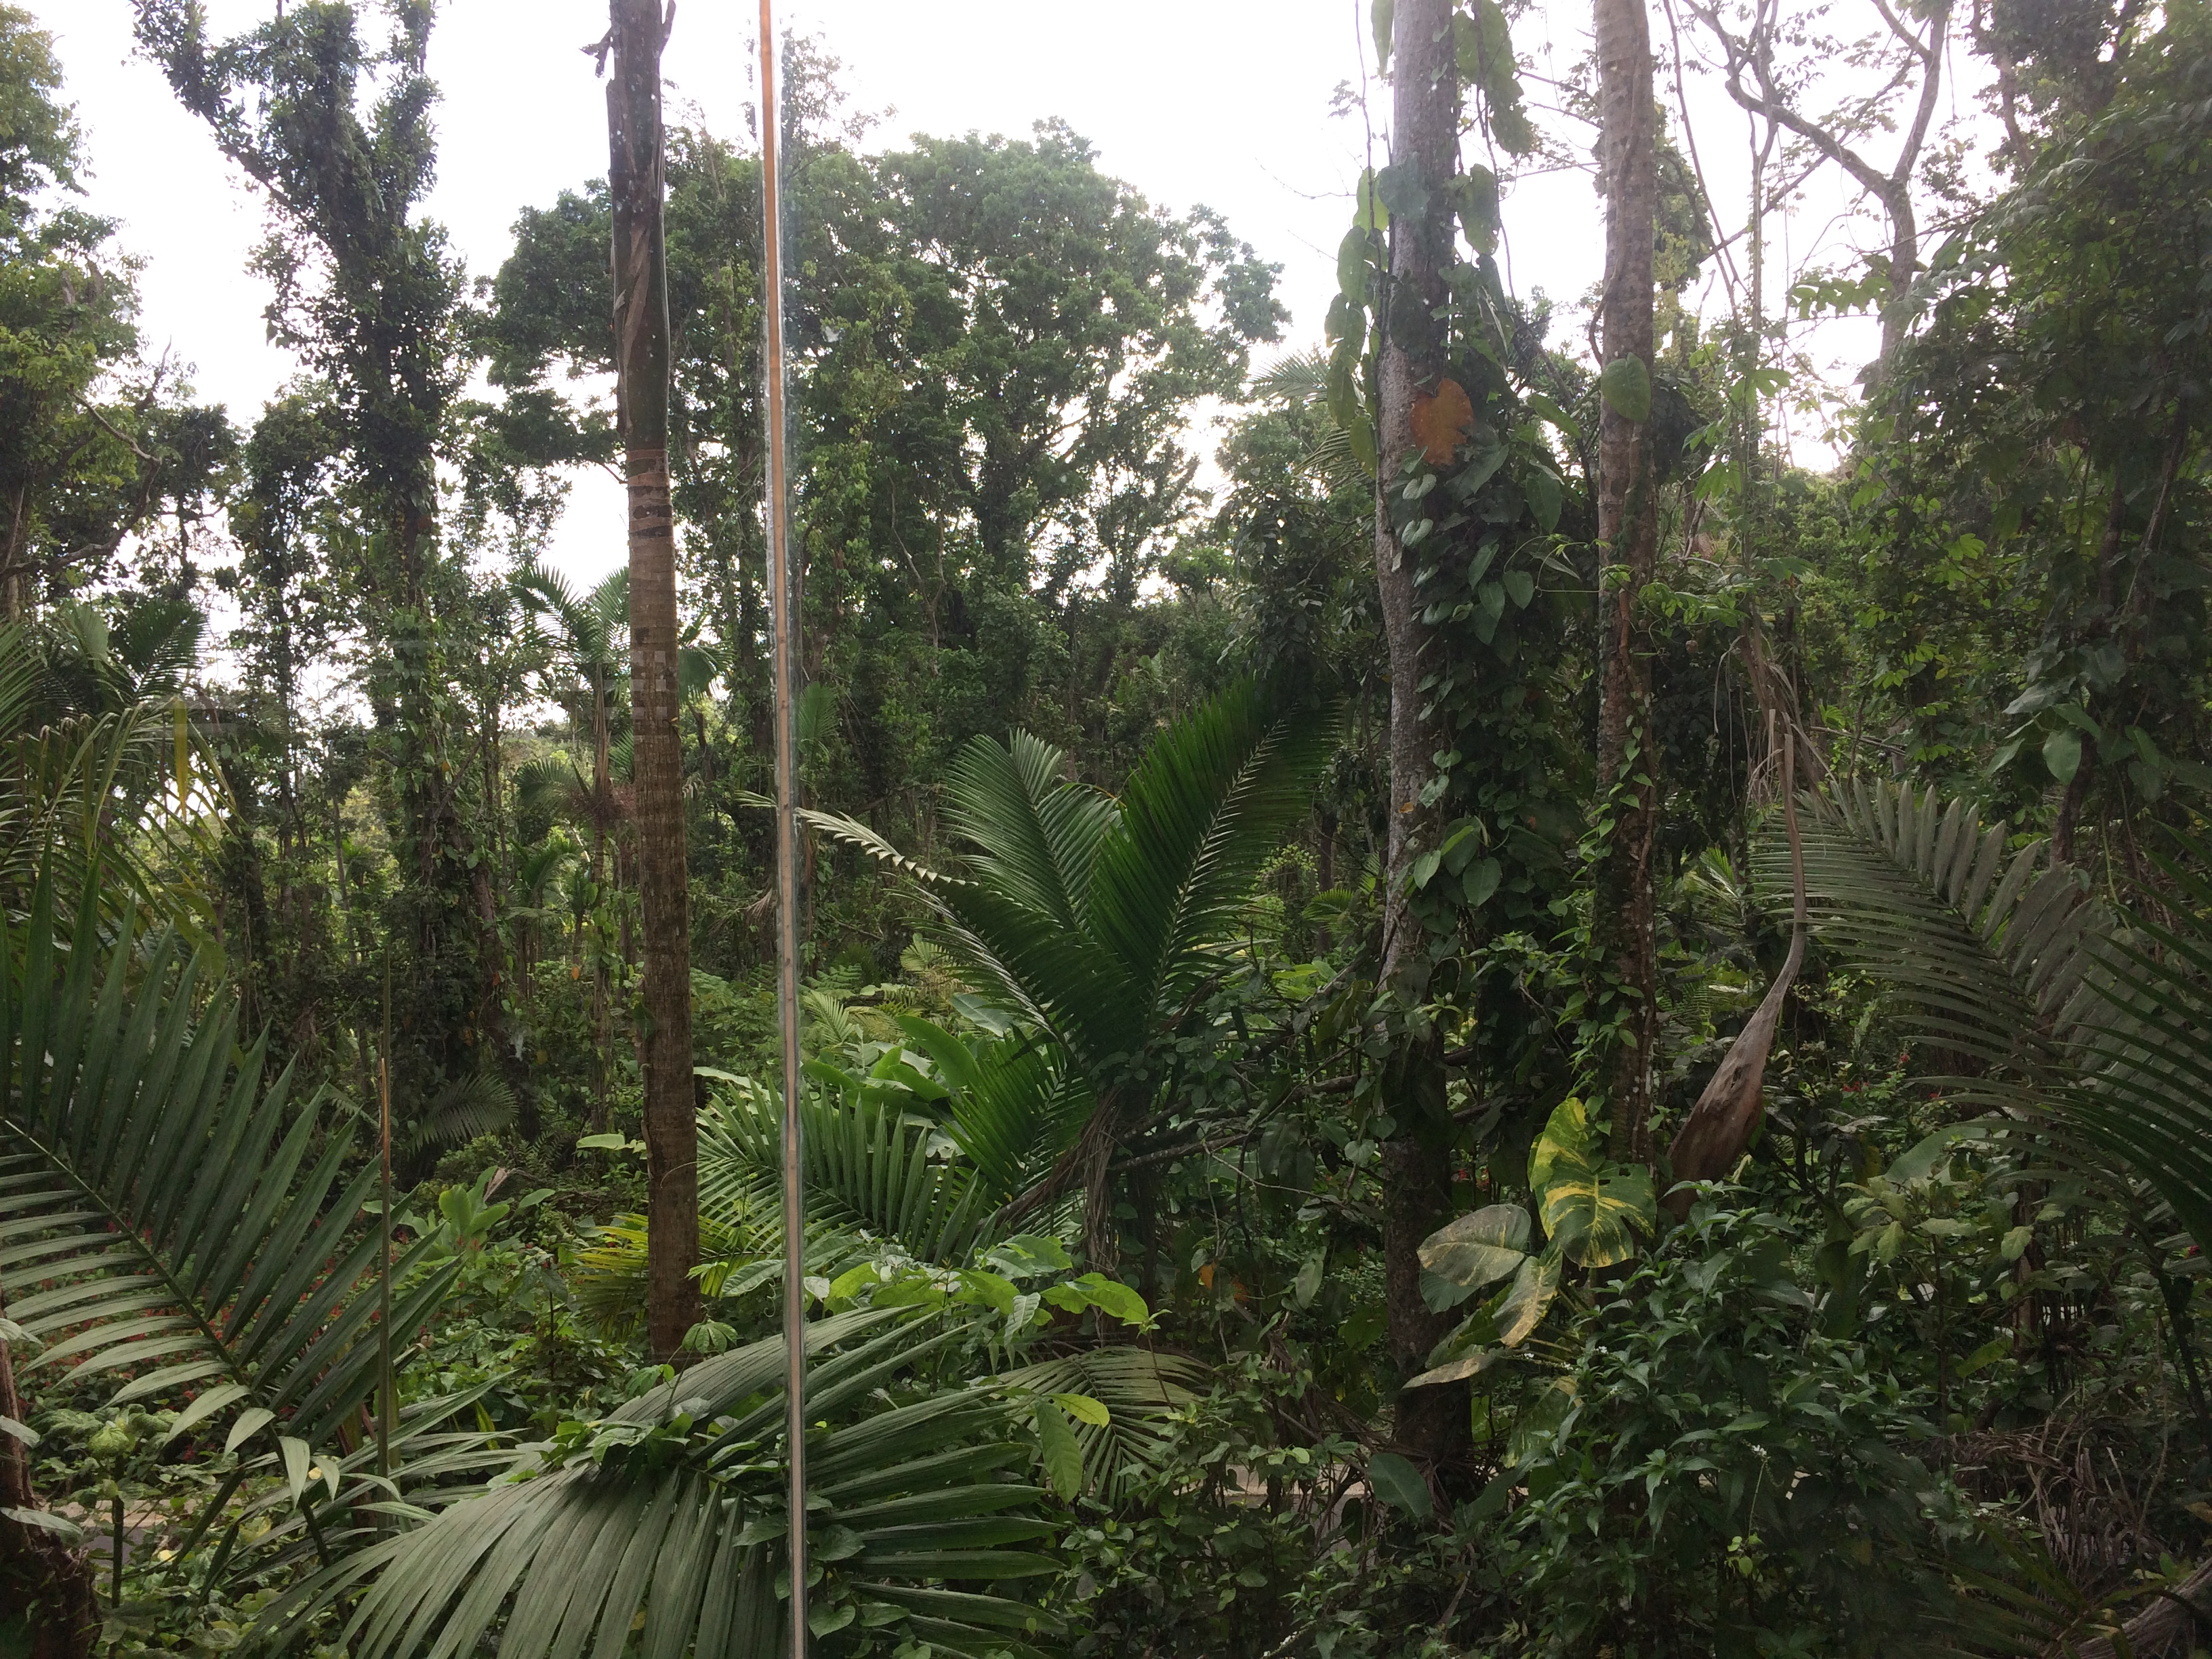
View from the lab, July 2018
Notes:
View from one of the research labs.

Slide 26
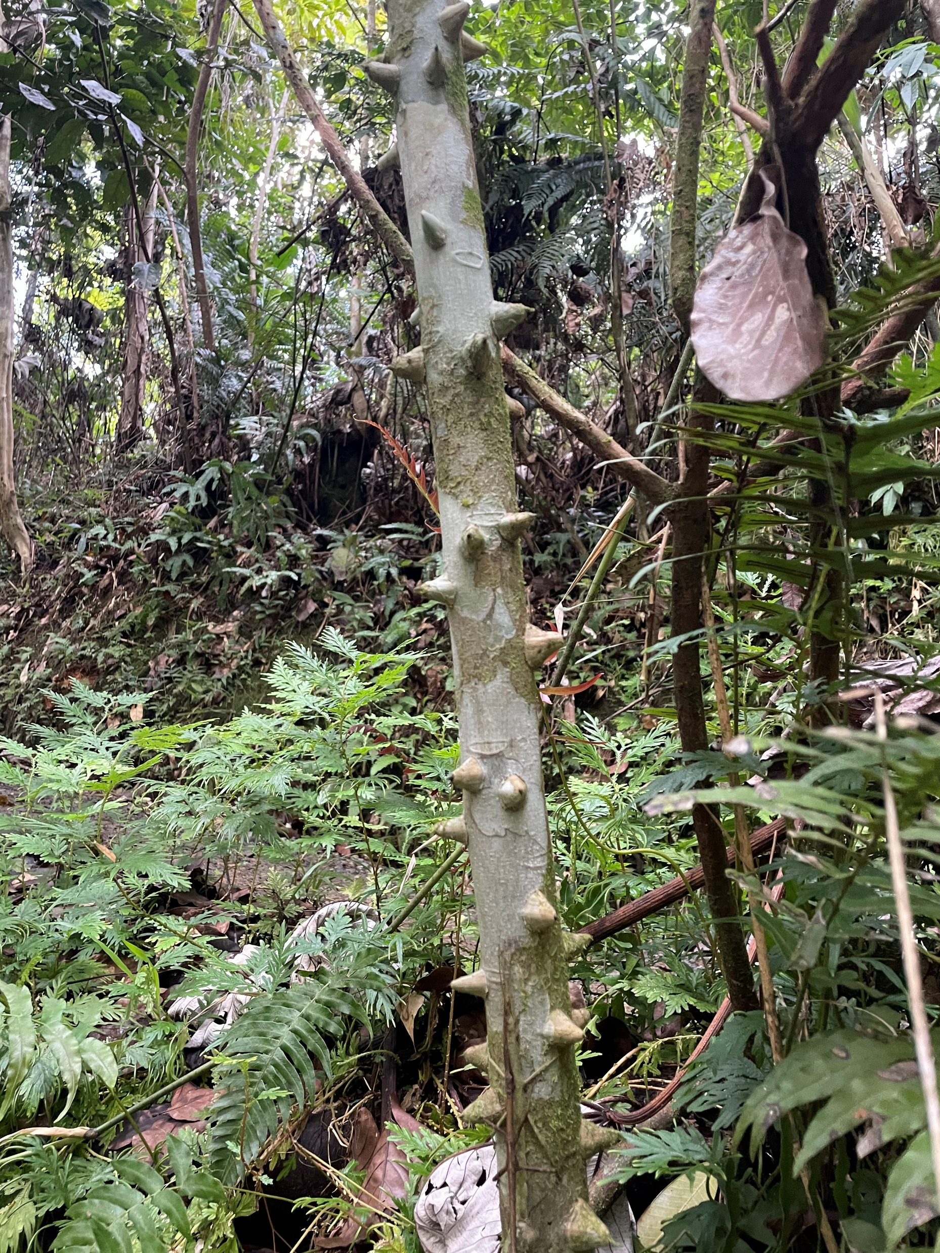
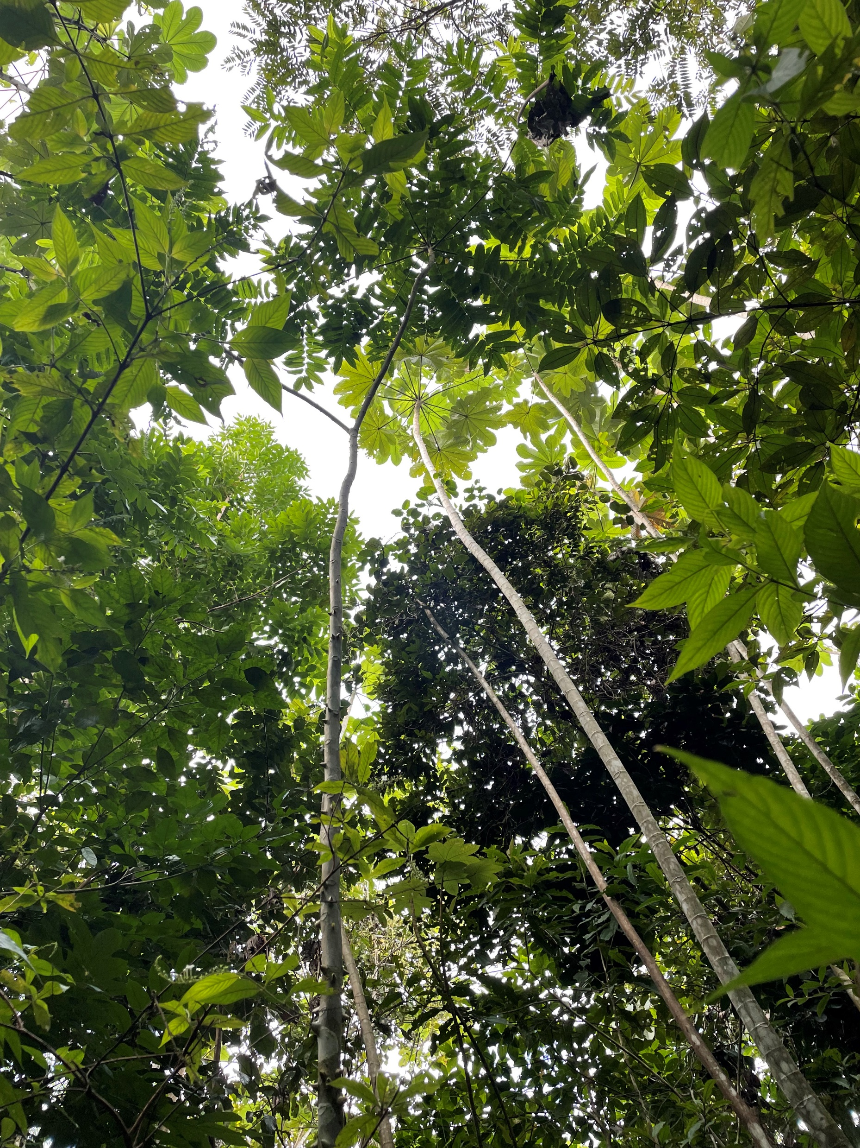
Regrowth started very quickly
Notes:
The forest during summer of 2022

Slide 27
Day Work

Slide 28
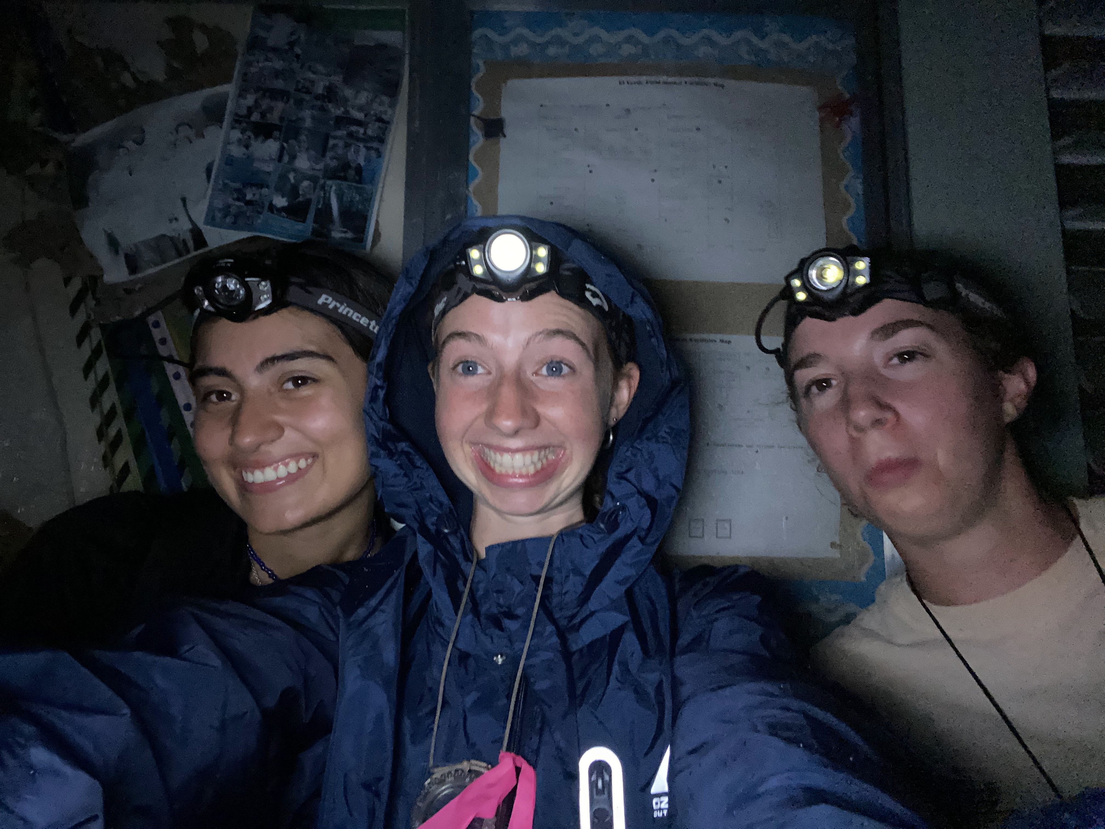
Night Work
Notes:
Night work lasts anywhere from 5-9 hours depending on what we are doing, so we have to carry water, snacks, and extra batteries as well as the necessary equipment to do the work.

Slide 29
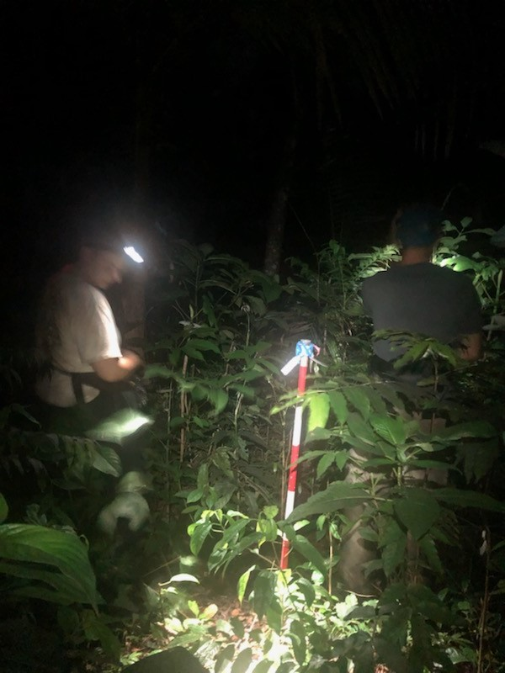
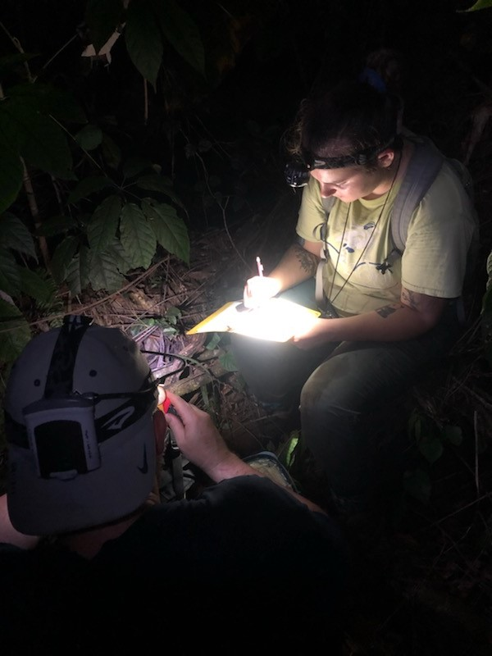
Night Surveys
Notes:
Surveying a point for gastropods and walking sticks.

Slide 30
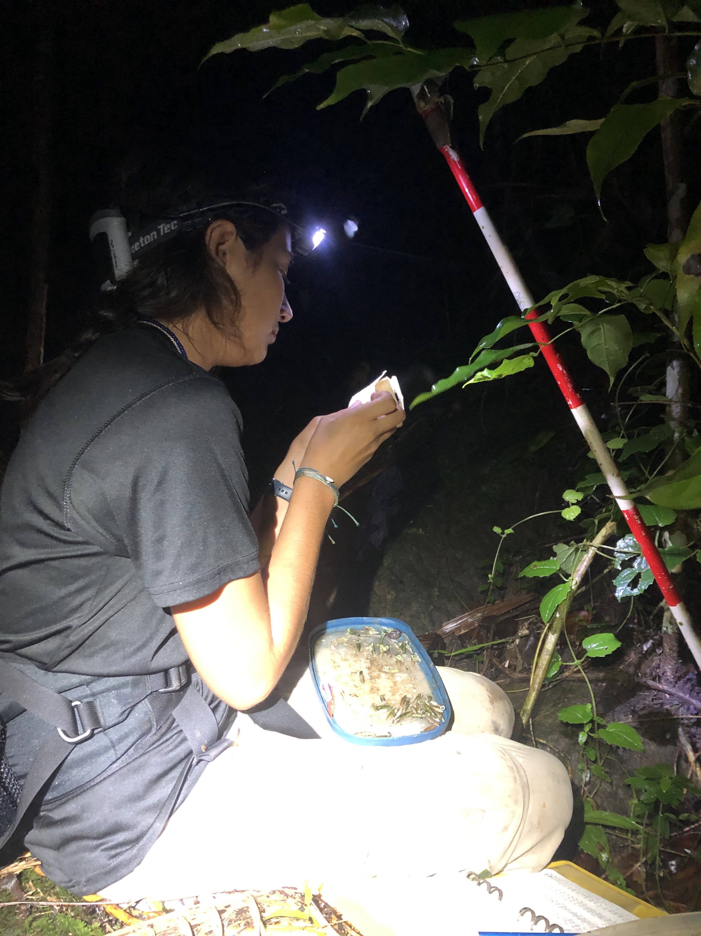
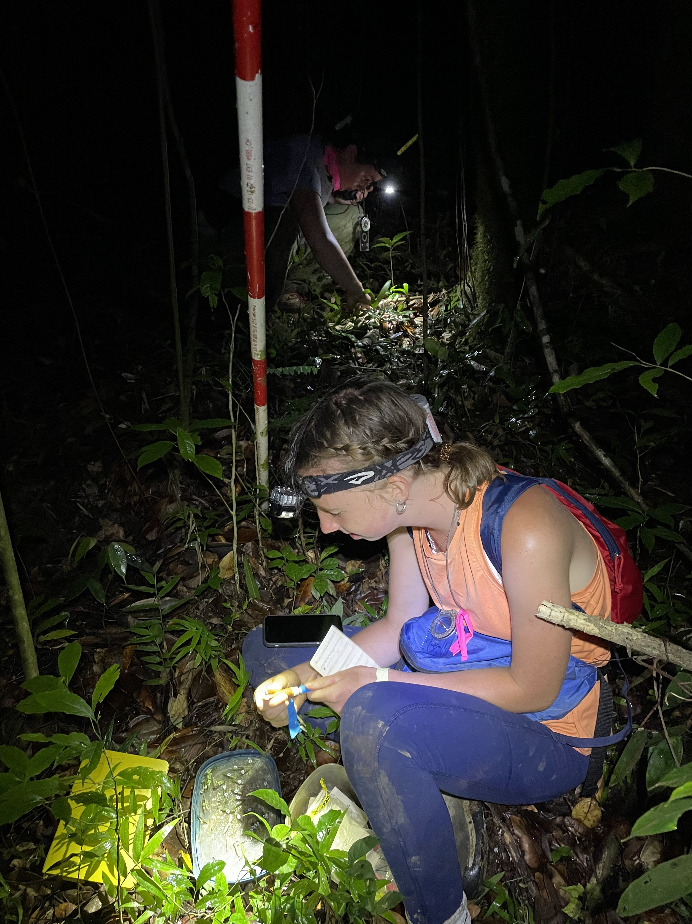
Night Surveys
Notes:
More point surveys, marking snails.

Slide 31
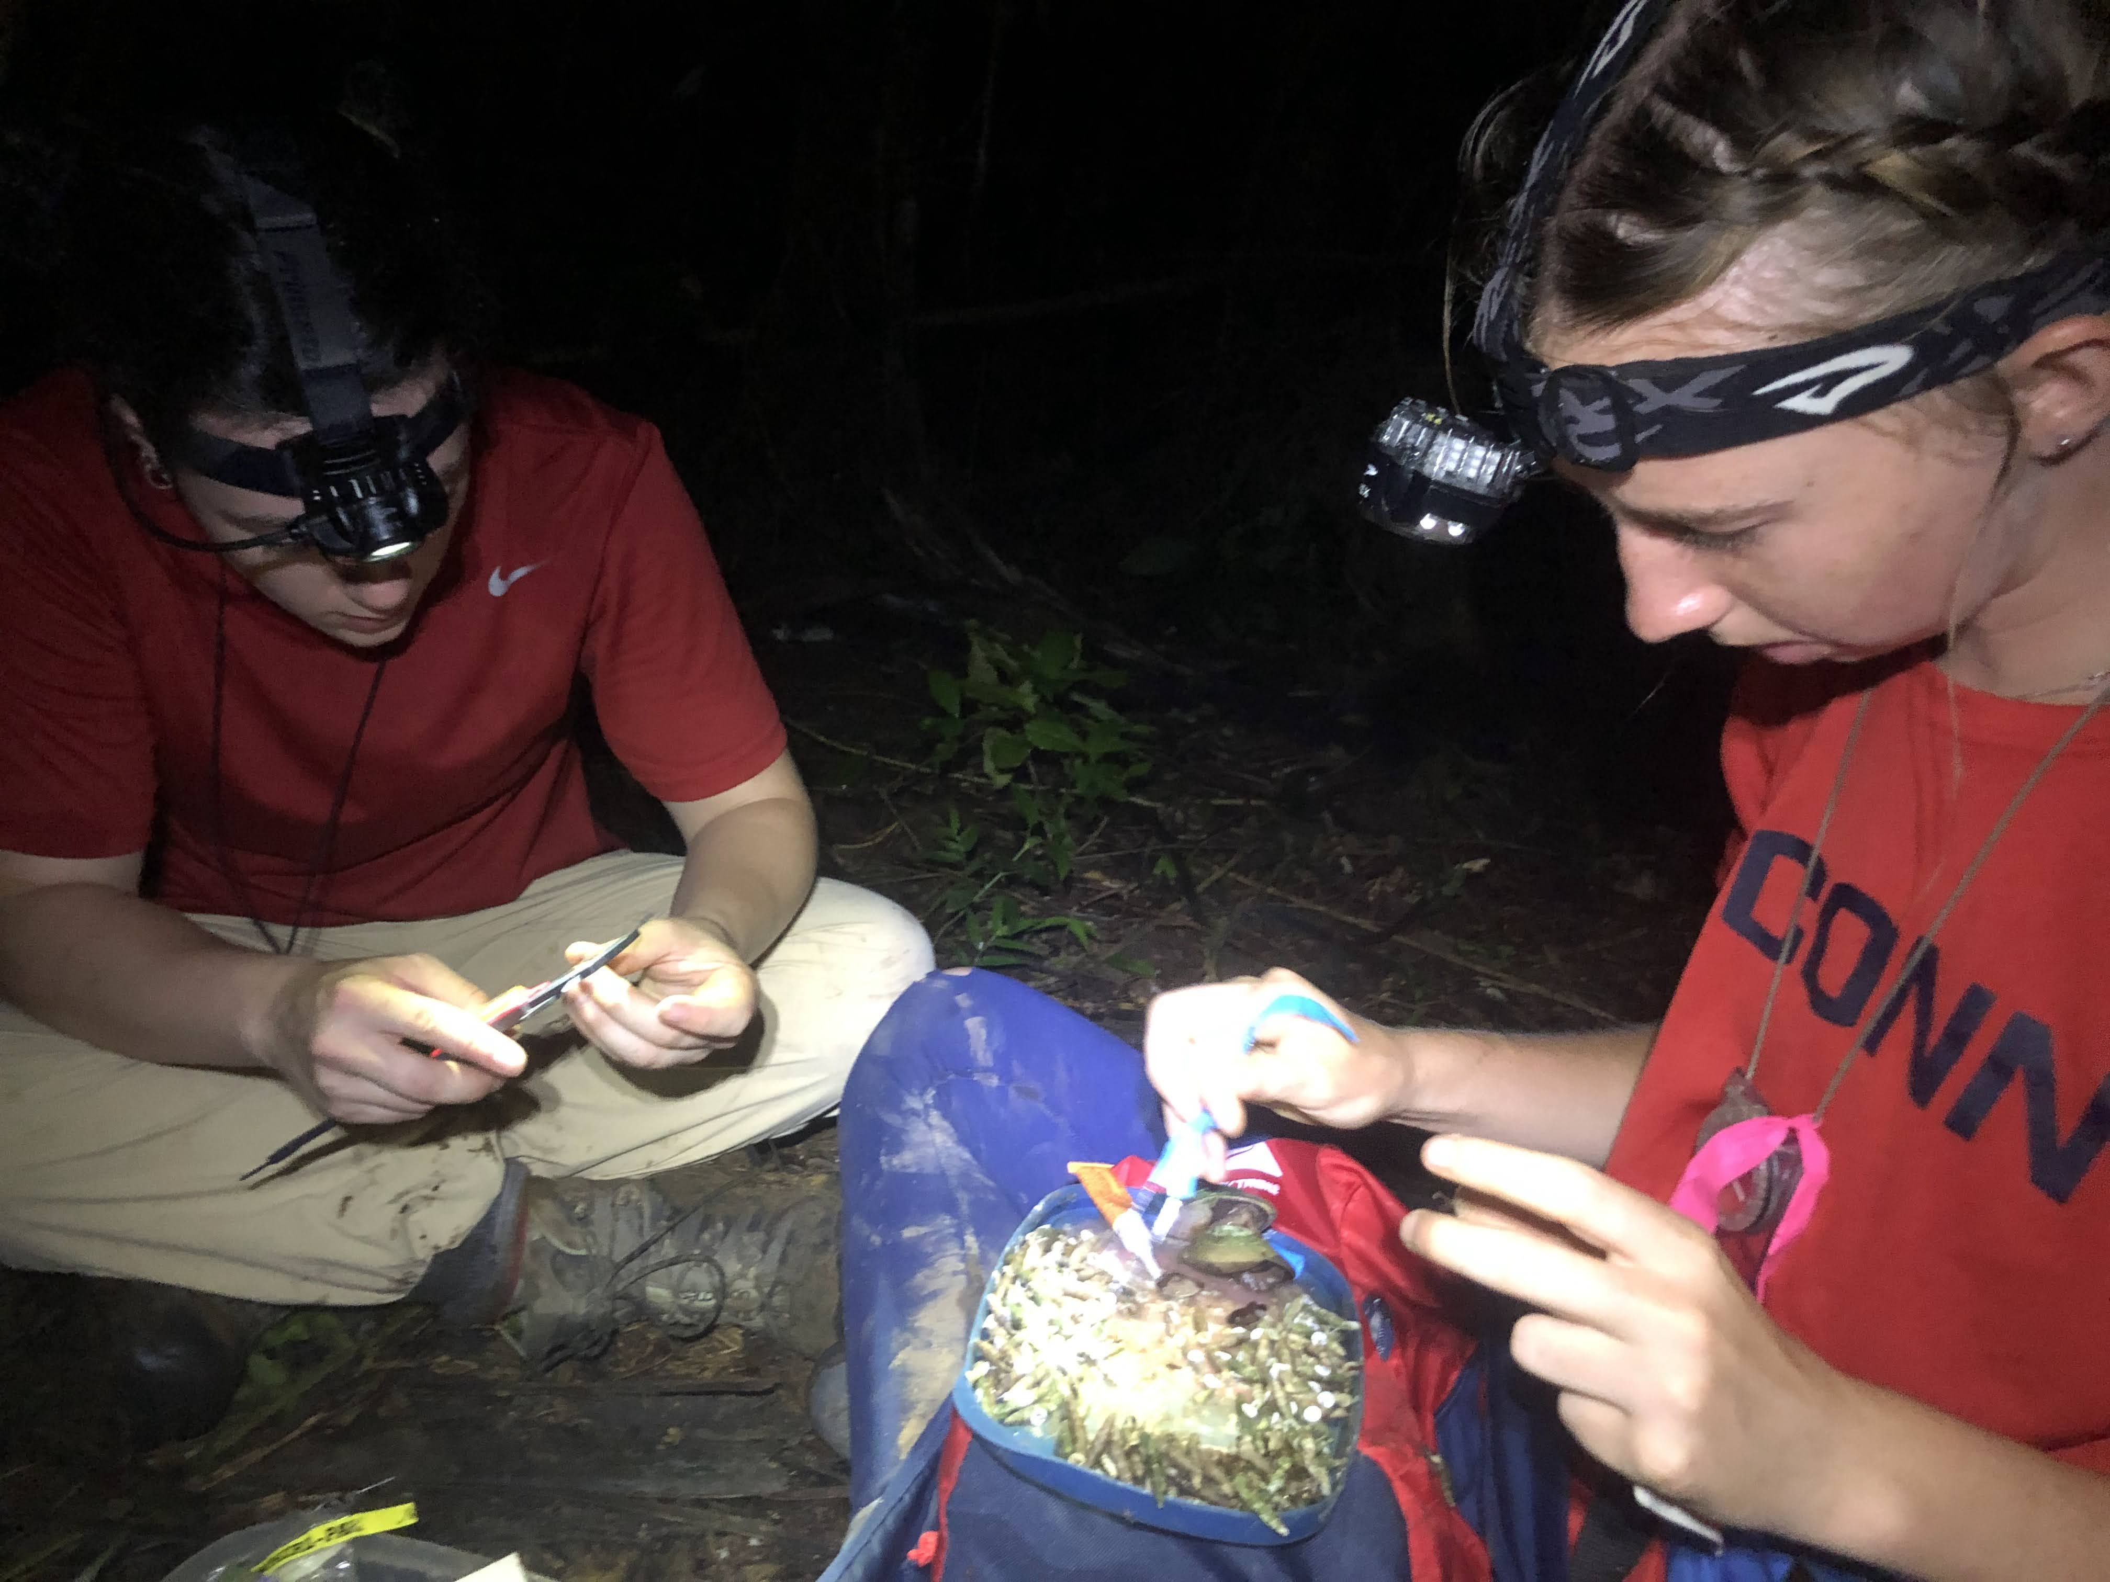
Night Surveys
Notes:
Sometimes we find A LOT of snails, measuring and marking individuals of the two most abundant species.

Slide 32
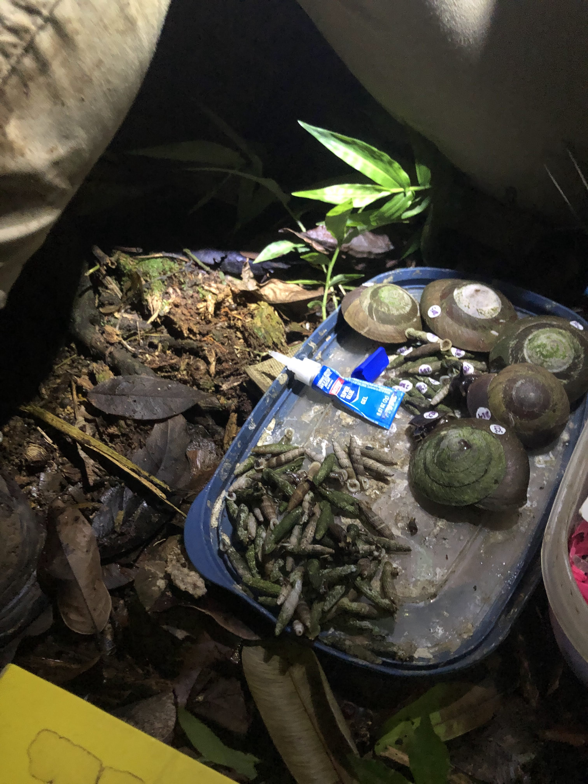
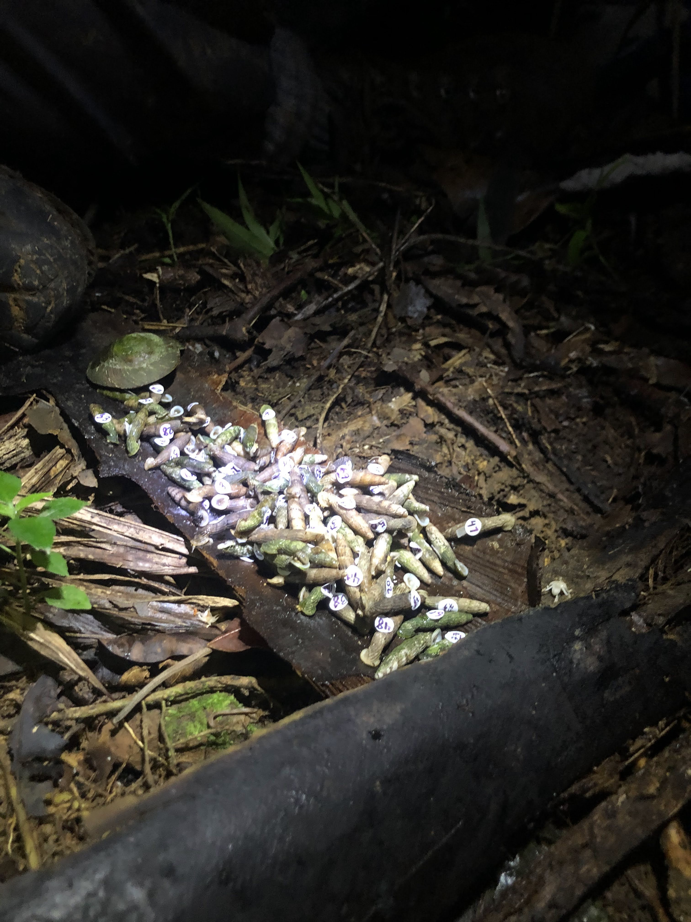
Night Surveys
Notes:
Sometimes there are lot of snails.

Slide 33
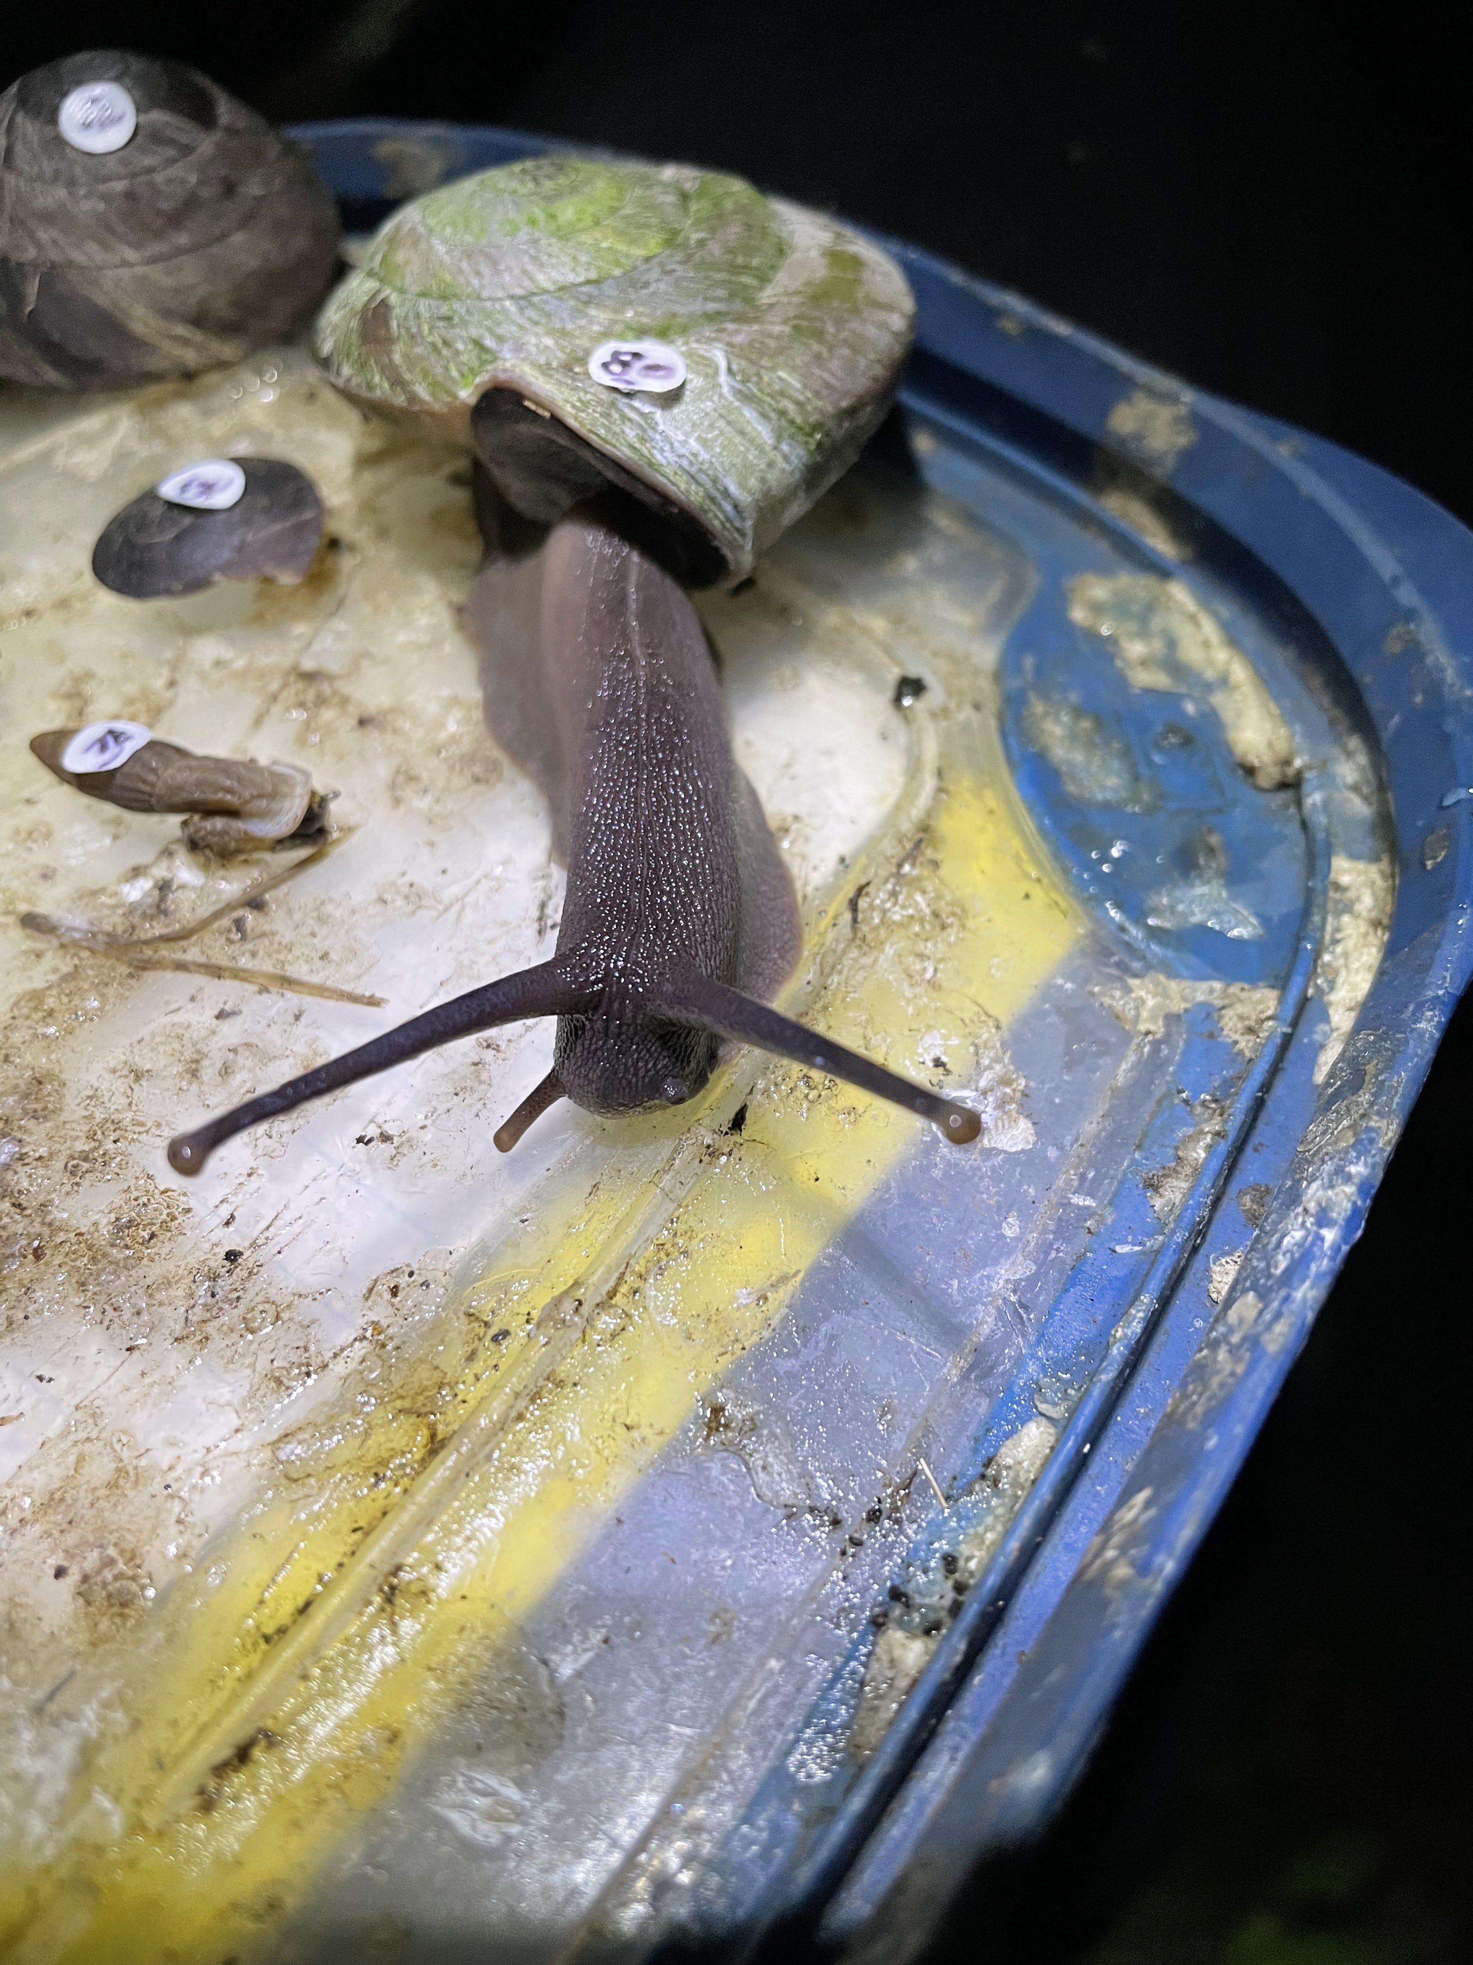
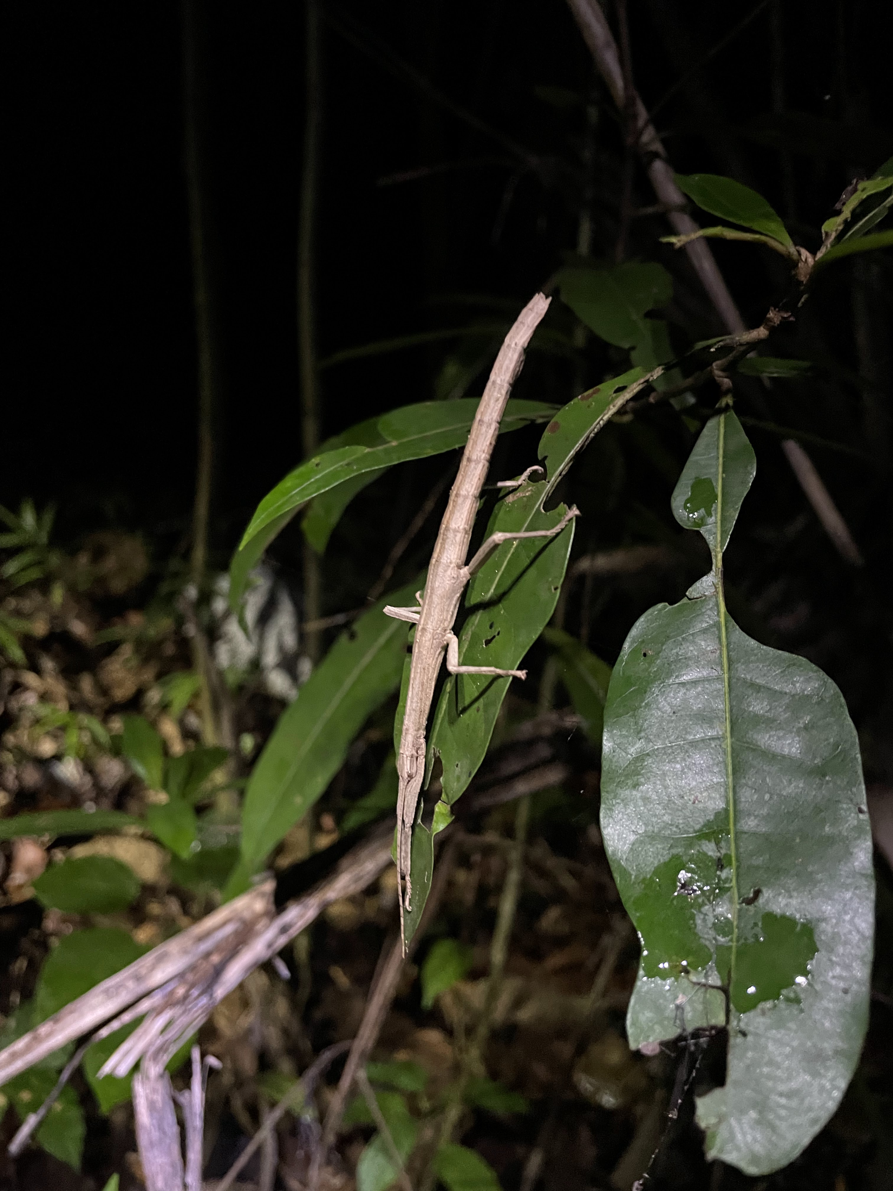
Night Surveys
Notes:
Snails are not always as patient as they would seem. We count and measure walking sticks, but try to not remove them from the plants they are on.

Slide 34
The Data Book

Slide 35
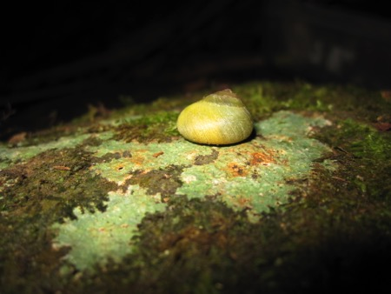
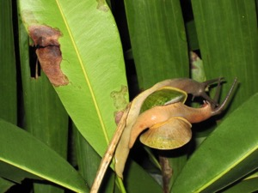
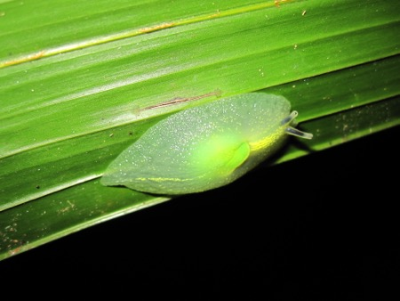
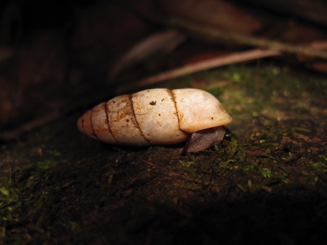
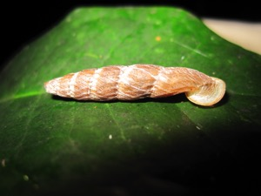
Gastropods
Notes:
You’ll learn to identify all of these and many more kinds of gastropods.

Slide 36
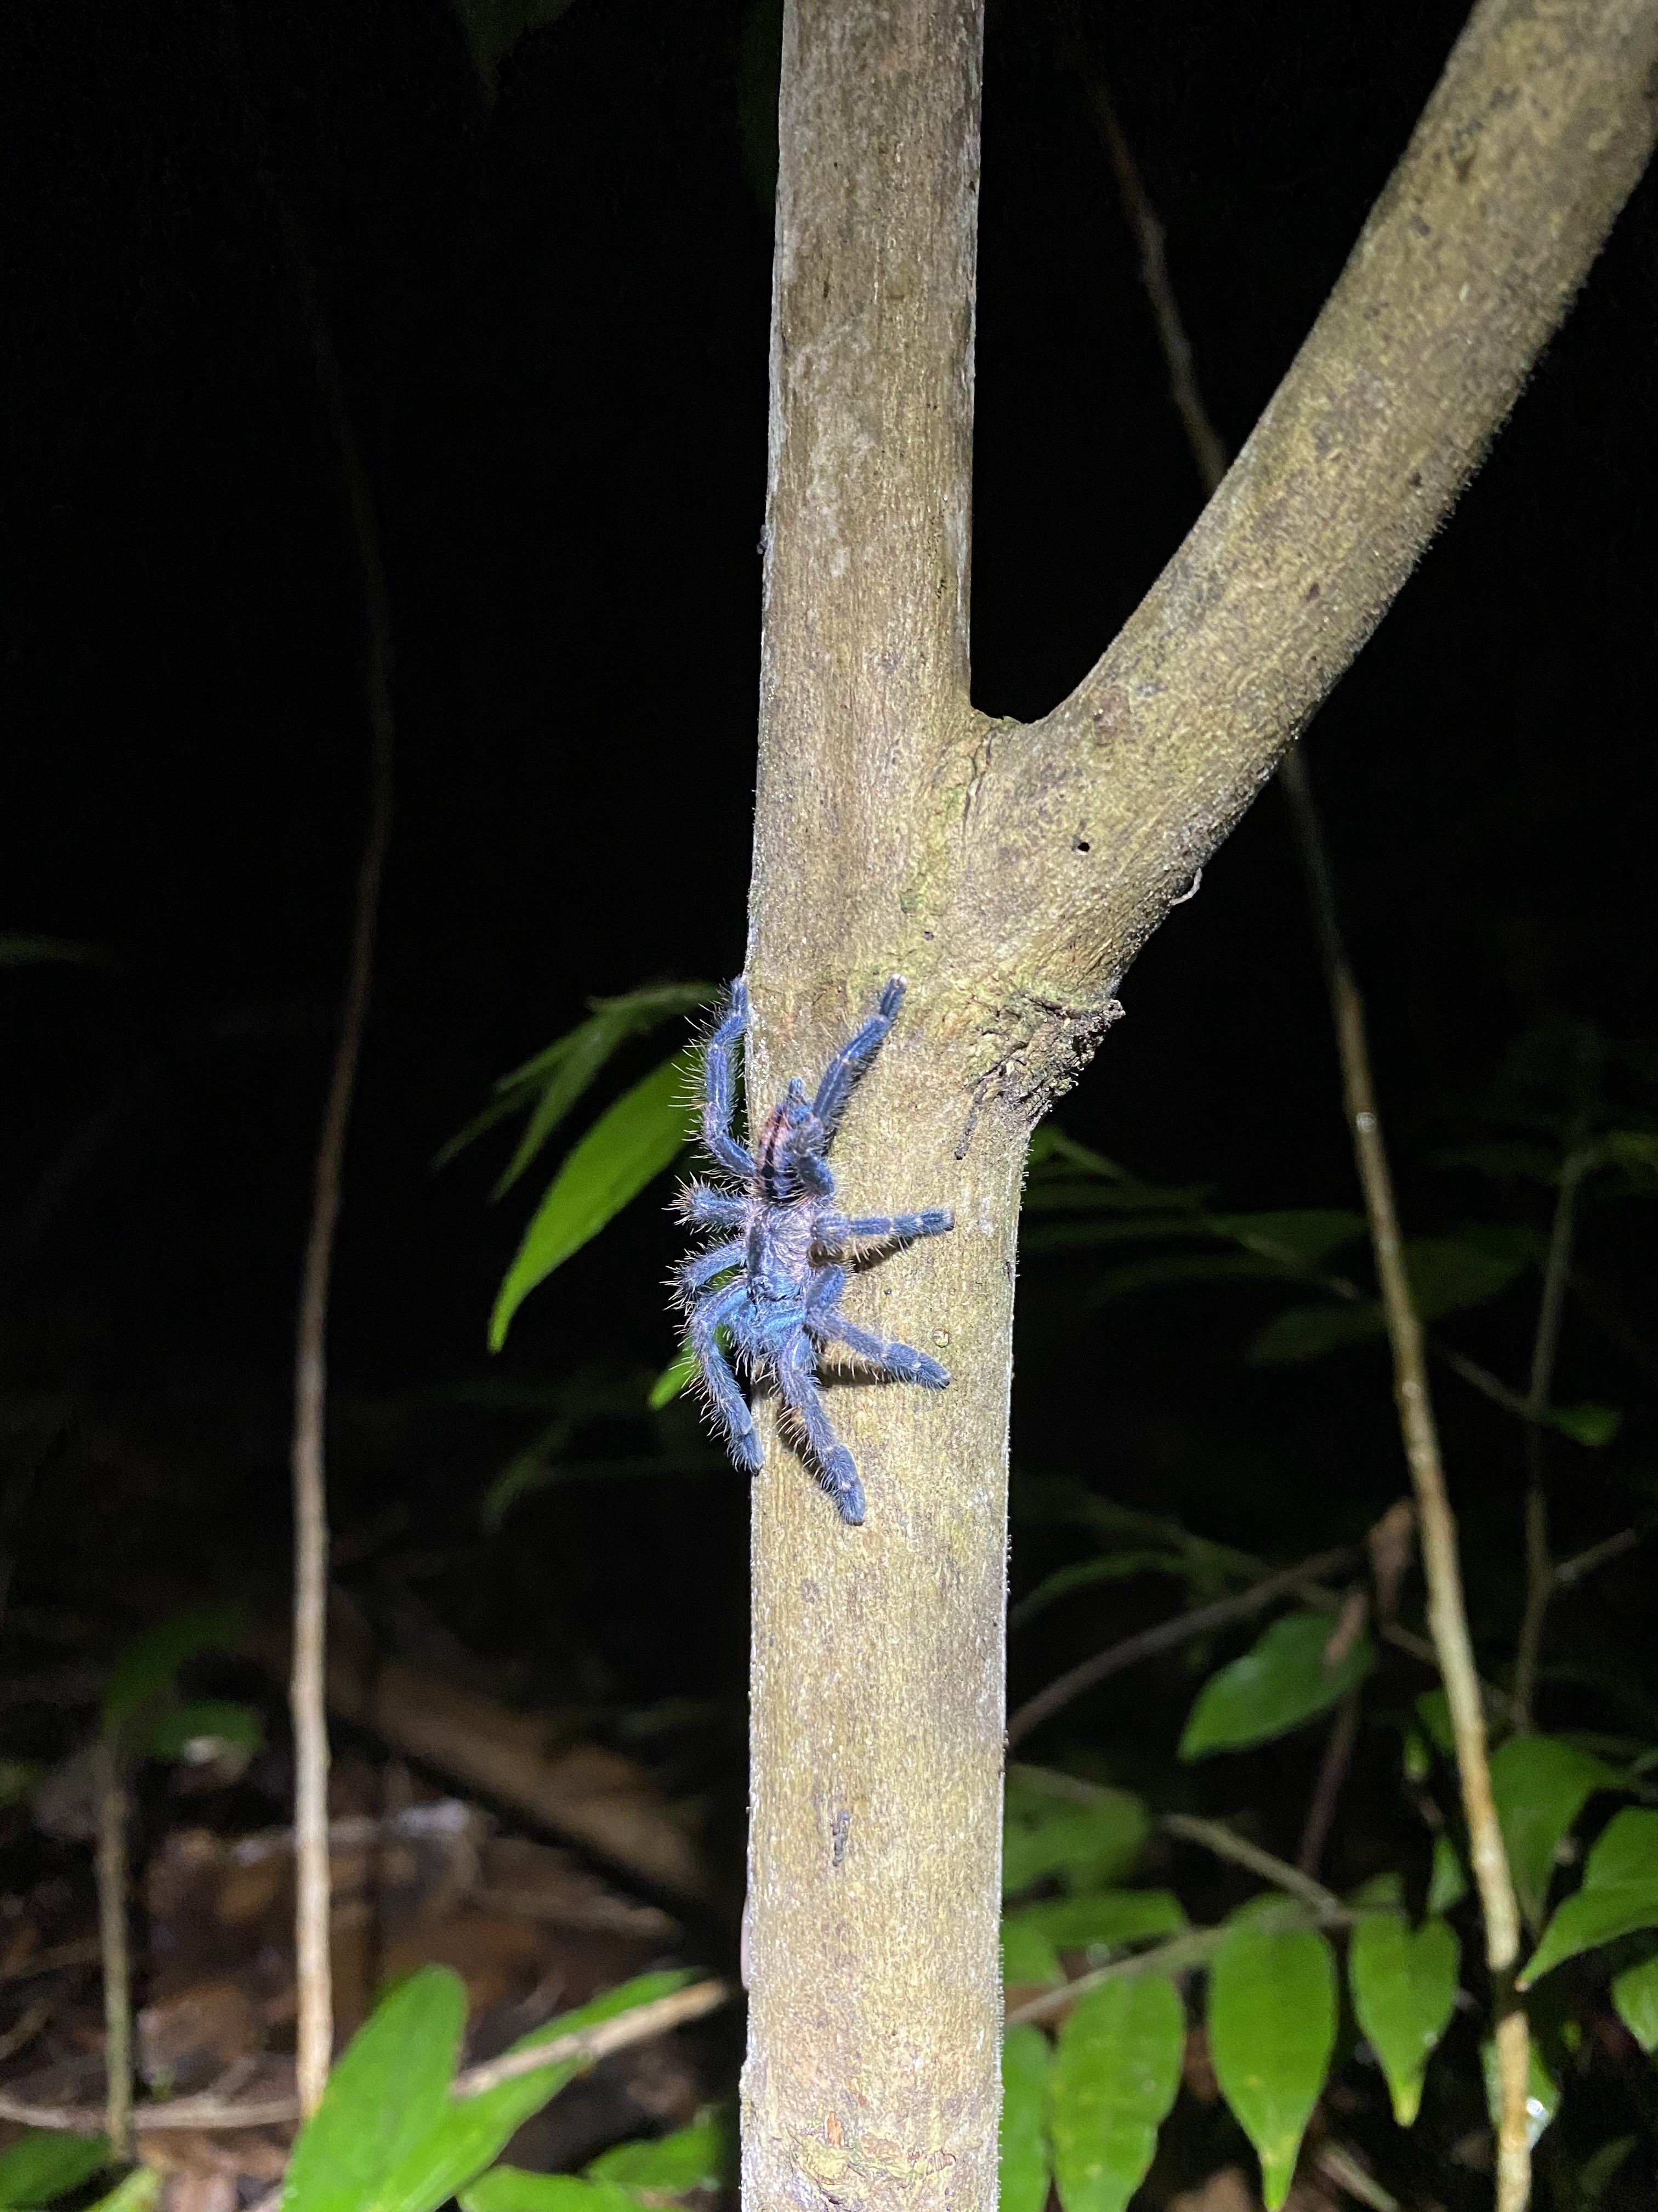
Rainforest at Night
Notes:
There are tarantulas in the forest, some are blue. There are also Puerto Rican Boas, which are small for boas. [This is a video if you want to play it.]

Slide 37
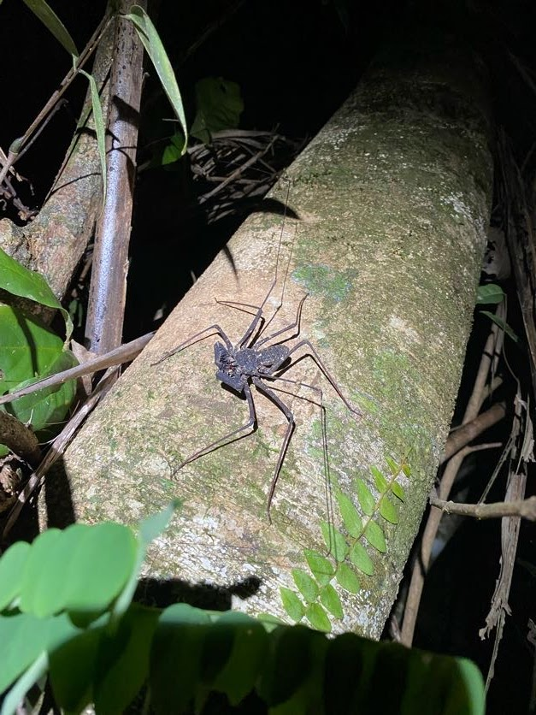
Rainforest at Night
Notes:
There are also tailless whipscorpions and “real” scorpions. The one on the right is a video.

Slide 38
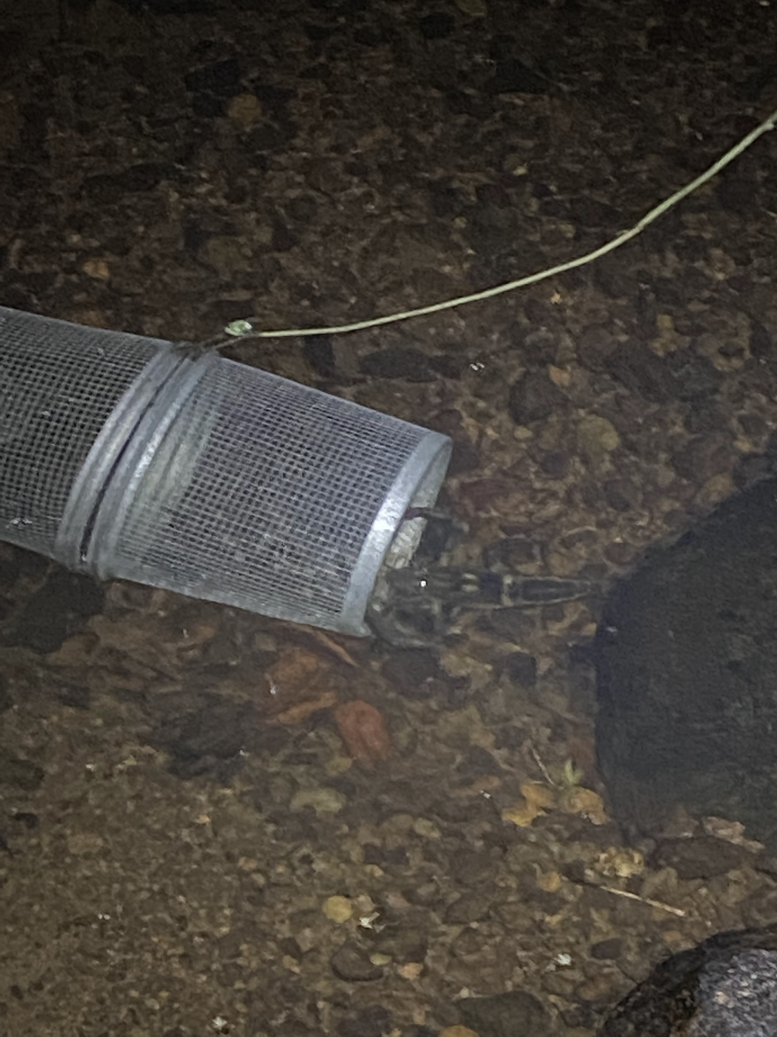
Rainforest at Night
Notes:
The forest is full of coquí at night like the from on the left (this is also a video) and there are some large “shrimp” in the streams that can grow up to a foot long.

Slide 39
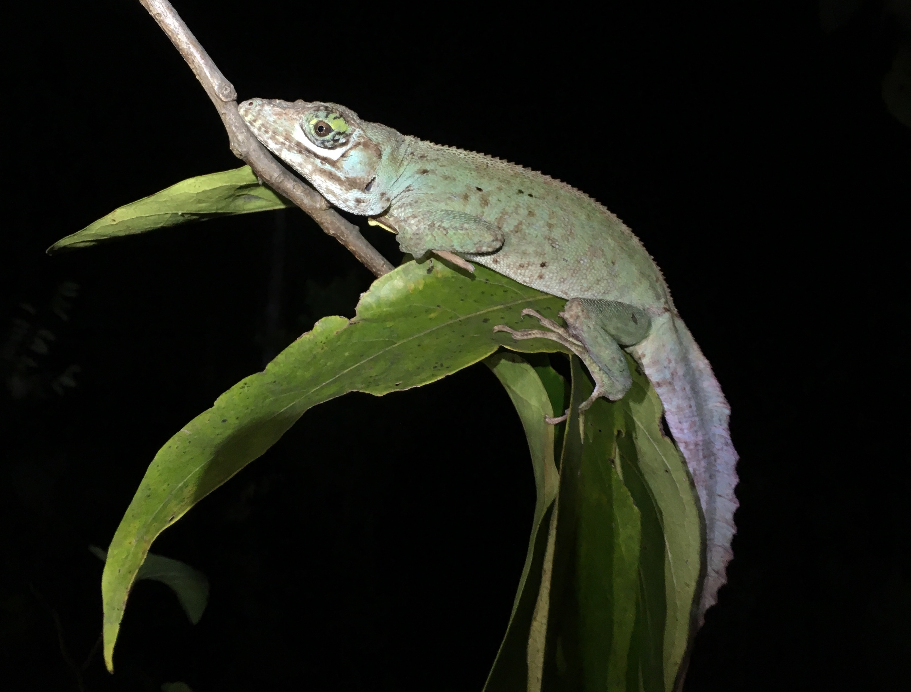
Rainforest at Night
Notes:
And sleeping anoles, too. This is a large Anolis cuvieri.

Slide 40
Rainforest at Night
Notes:
There are a lot of tailless whipscorpions, which are harmless unless you are a small animal.

Slide 41
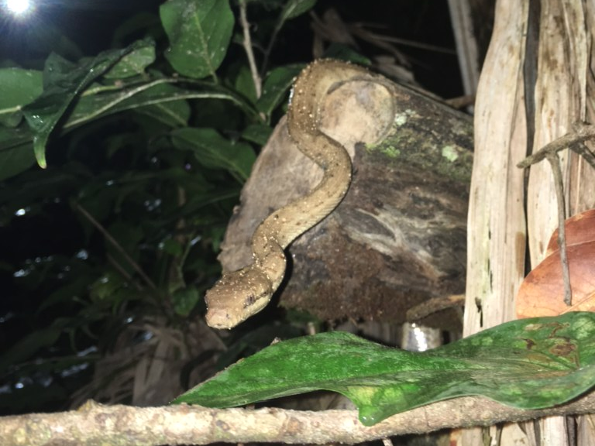
Rainforest at Night
Notes:
The Puero Rican boa can be found at Luquillo. It was once thought to be rare and is listed as endangered, but over the last few decades people have realized that it is quite common, it just spends nearly all of its time in the forest canopy. Now that the forest canopy is largely gone, we see boas during our night work quite often.

Slide 42
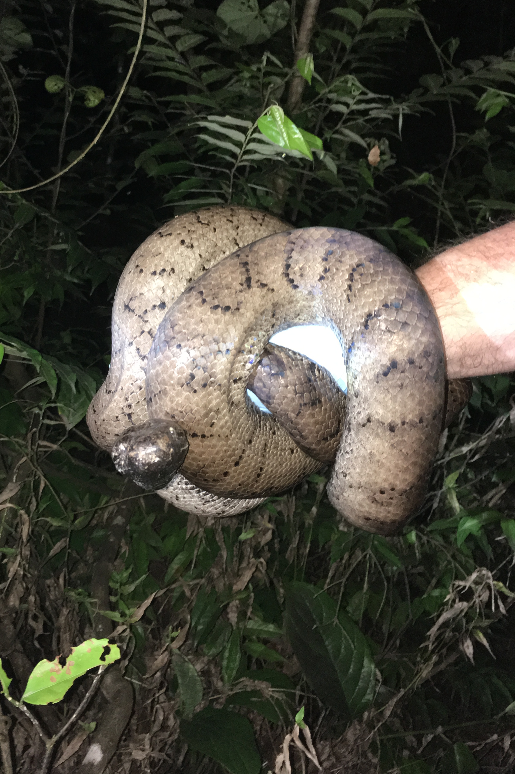
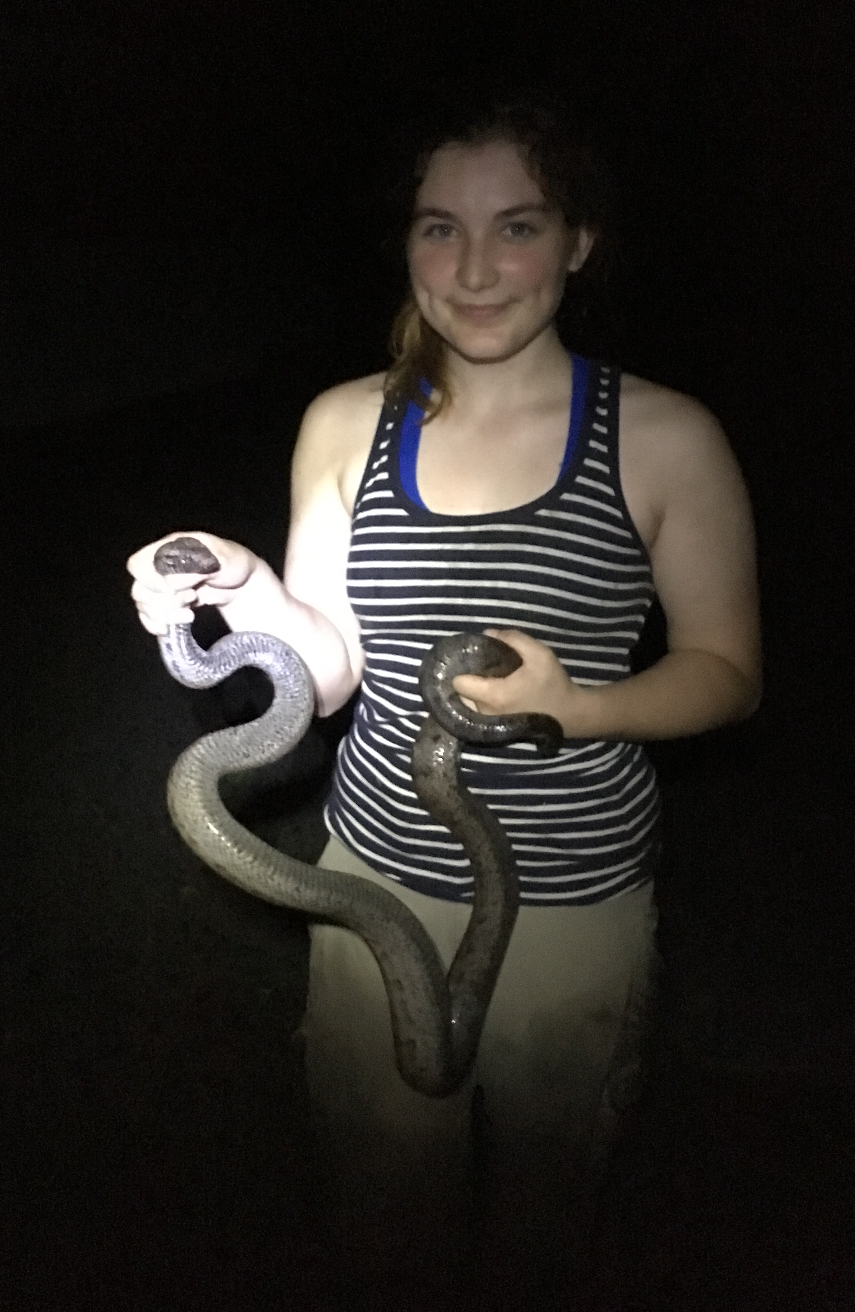
Rainforest at Night

Slide 43
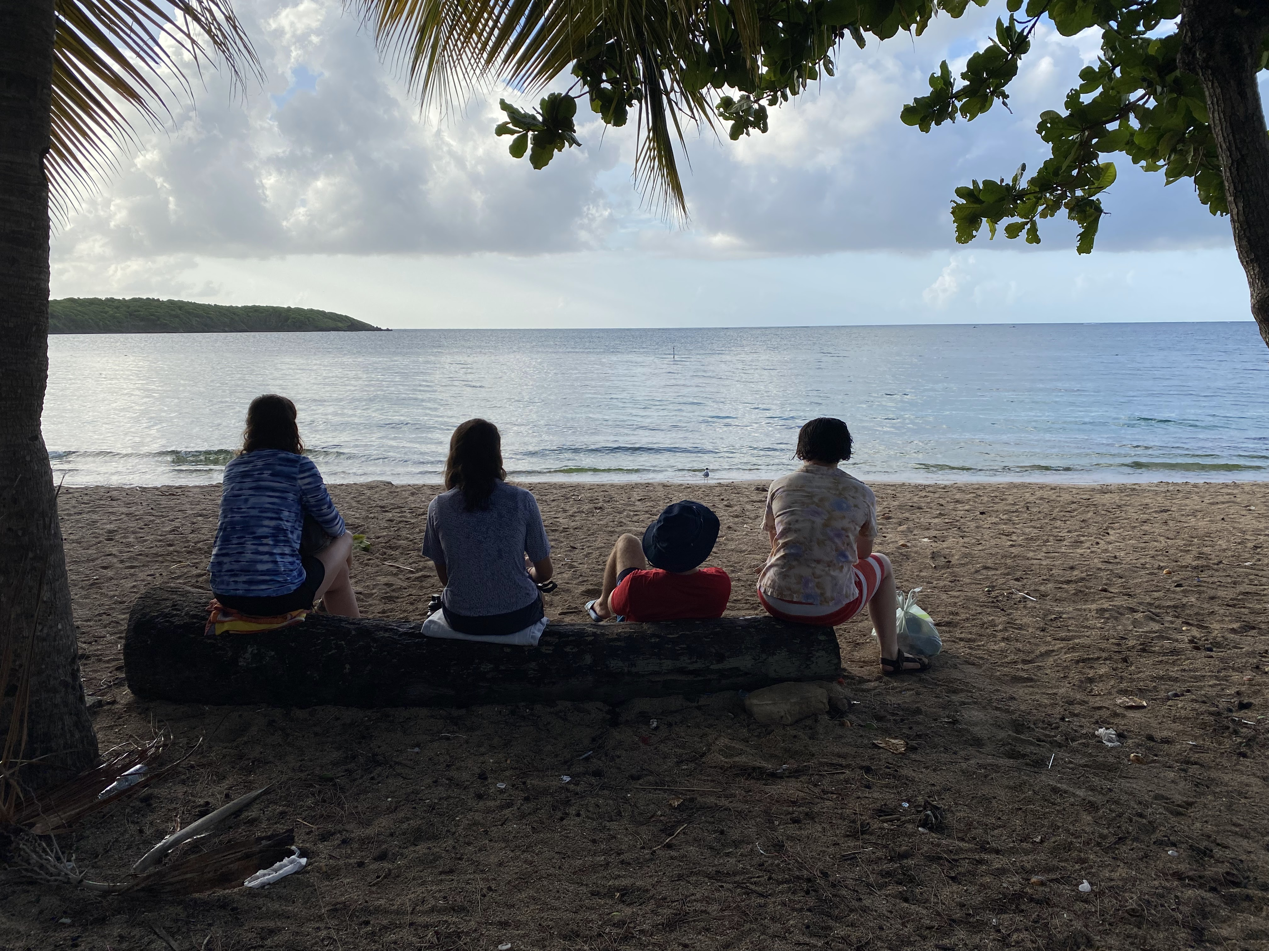
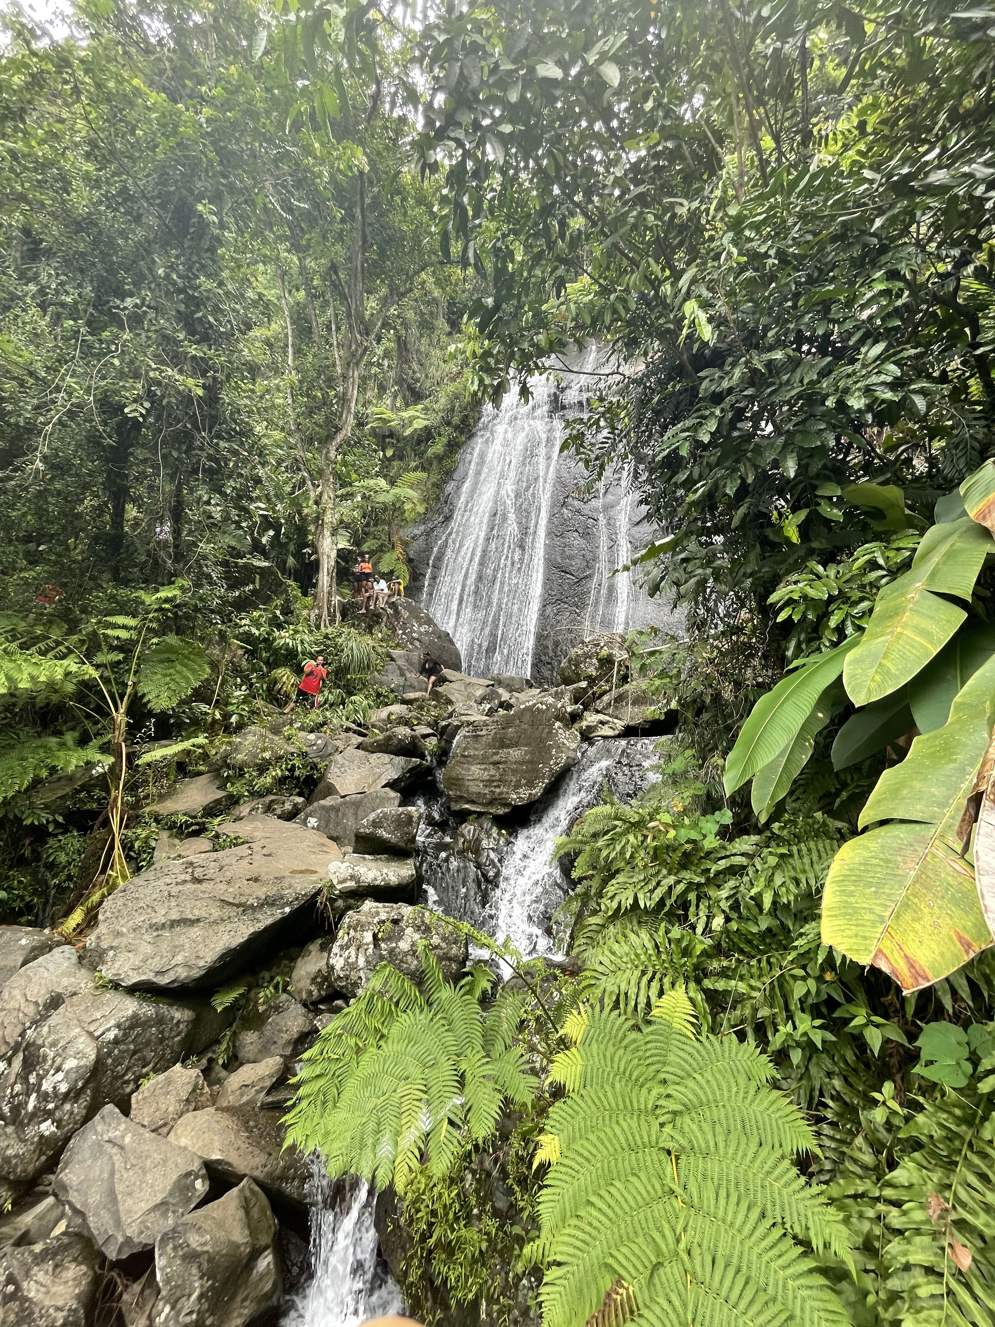
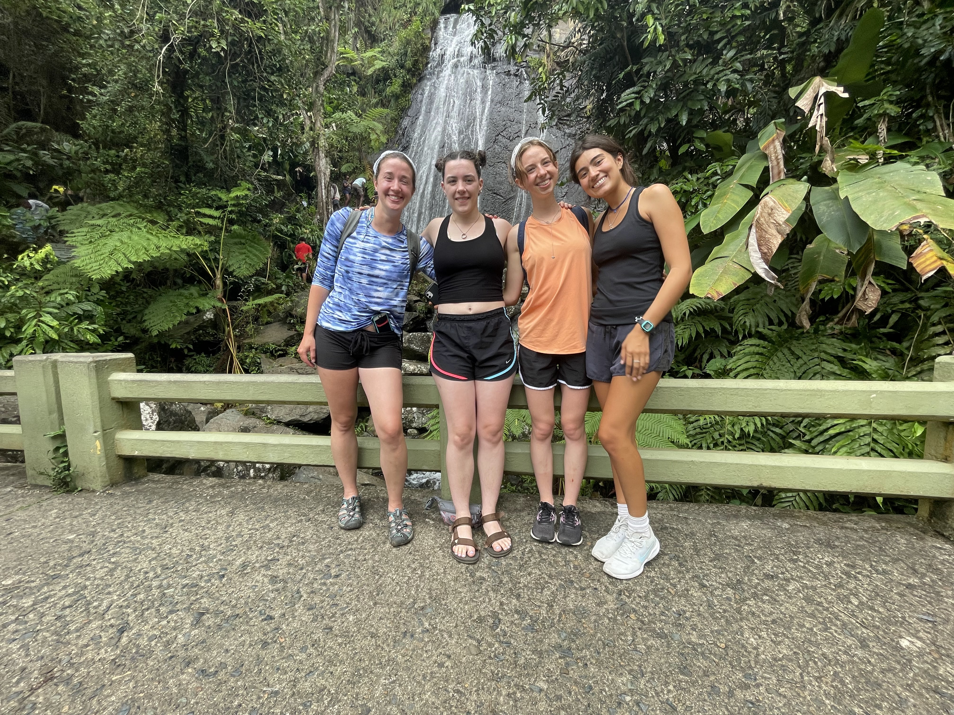
Other Fun
Notes:
If we have the time and energy, there are beaches and cultural experiences to enjoy.

Slide 44
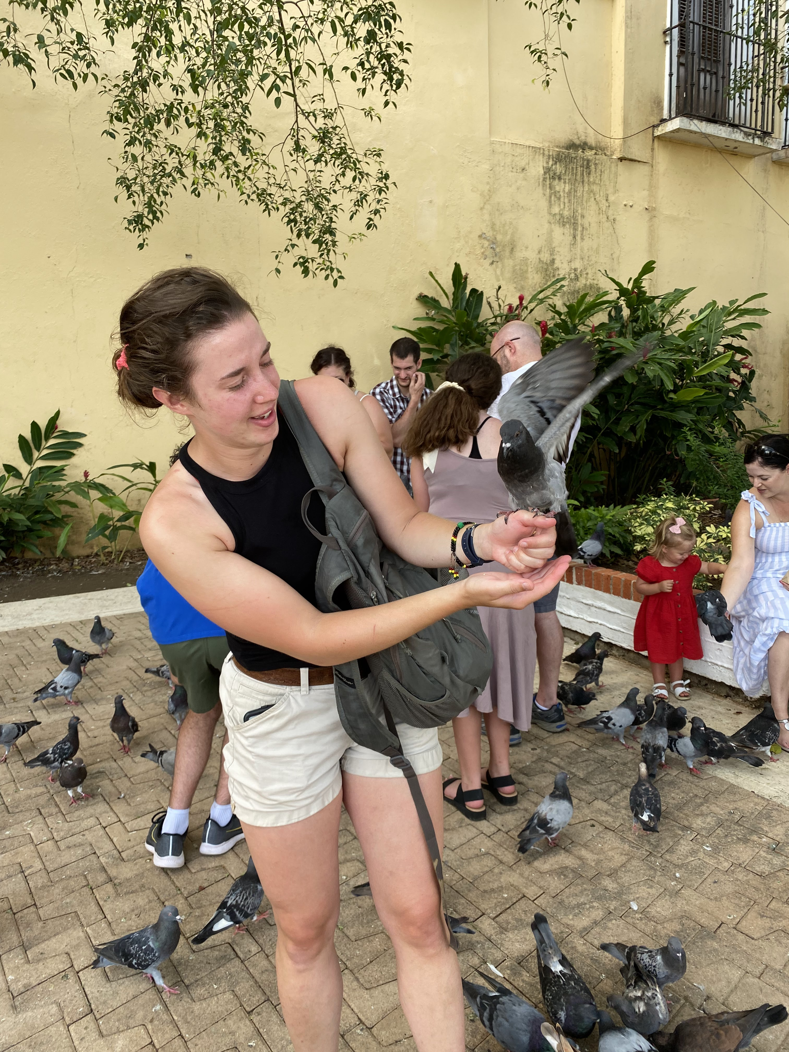
Other Fun
Notes:
If we have the time and energy, there are beaches and cultural experiences to enjoy. The one of the dog is a video.

Slide 45
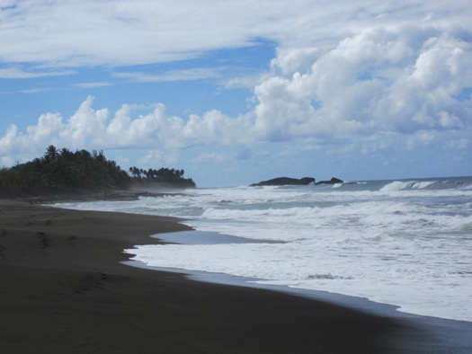
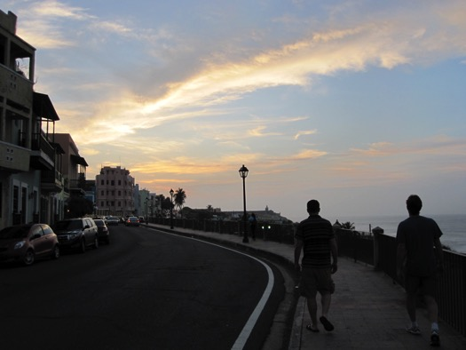
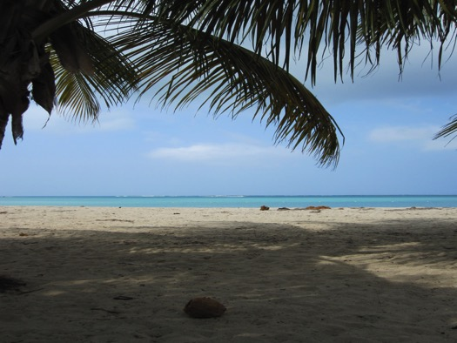
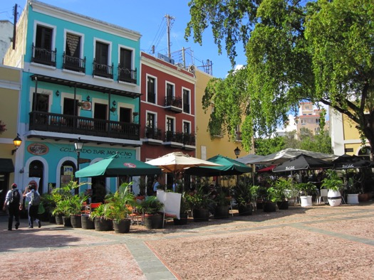
Other Fun
Notes:
If we have the time and energy, there are beaches and cultural experiences to enjoy.

Slide 46
Thank You!
Notes:
Puerto Rican Screech Owl at the field station.

